Slide 1
Let’s Talk “SaaS”
SaaS: Standards as a Service
50th REFEDS Meeting | Brighton, UK | 13 June 2025
Albert Wu, InCommon | REFEDS

Slide 2
The next 30 minutes is a conversation — not a monologue.
We’ve got time, so let’s use it well.
Your voice belongs in this. Speak up, jump in.
TNC24 Reception | Rennes, FR

Slide 3
About REFEDS
Our Mission
Established in 2005, REFEDS is a community-driven international group of thought leaders delivering cutting-edge innovative trust and identity solutions for research and education.
Our mission is to provide an open collaboration hub for stakeholders in the Research and Education identity federation ecosystem to learn, educate, and build standards and best common practices for federations internationally.

Slide 4
20 Years of Cultivating Trust: the Standards that Shaped Federated Identity
Entity Categories
Research and Scholarship (R&S) v1.3 Facilitates attribute release for services supporting research and scholarship. http://refeds.org/category/research-and-scholarship
Hide From Discovery v1 Allows entities to be hidden from discovery interfaces. http://refeds.org/category/hide-from-discovery
Anonymous Access v2 Supports access without releasing identifying attributes. https://refeds.org/category/anonymous
Pseudonymous Access v2 Enables access with pseudonymous identifiers. https://refeds.org/category/pseudonymous
Personalized Access v2 Allows personalized services while respecting privacy. https://refeds.org/category/personalized
Code of Conduct v2 Establishes best practices for data protection and privacy. https://refeds.org/category/code-of-conduct/v2
Profiles
Multi-Factor Authentication (MFA) Profile v1.2 Defines requirements for MFA in federated environments. https://refeds.org/profile/mfa
Single-Factor Authentication (SFA) Profile v1 Outlines standards for single-factor authentication. https://refeds.org/profile/sfa
Error Handling URL Profile v1 Specifies standardized error handling mechanisms. https://refeds.org/specifications/errorurl-v1
Metadata Extensions & Attributes
Security Contact Metadata extension to specify security contact information. http://refeds.org/metadata/contactType/security
SIRTFI v1 & v2 Security Incident Response Trust Framework for Federated Identity. https://refeds.org/sirtfi
Schemas
eduPerson LDAP schema for representing person and organizational attributes in higher education. https://wiki.refeds.org/display/STAN/eduPerson
SCHAC (SCHema for ACademia) Schema for representing academic attributes. https://wiki.refeds.org/display/STAN/SCHAC
voPerson Schema for representing virtual organization person attributes. https://wiki.refeds.org/display/STAN/voPerson
RFC 8409 Defines SAML attribute types for entity categories. https://tools.ietf.org/html/rfc8409
Frameworks
REFEDS Assurance Framework (RAF) v2 Provides a structured approach to identity assurance. https://refeds.org/assurance
Baseline Expectations v1 Defines common operational expectations for federation participants. https://refeds.org/baseline-expectations

Slide 5
Co-op farm: a type of farm that is jointly owned and operated by a group of people who share in the decision-making, labor, and/or profits.
stockcake.com | aerial garden view

Slide 6
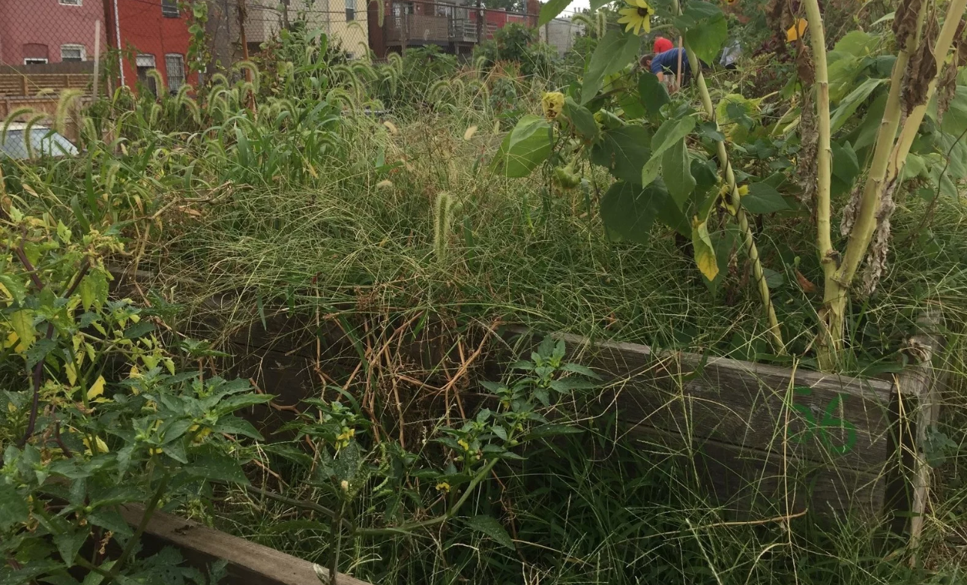
Healthy farms don’t happen by accident — pruning and weeding are part of the deal. Without tending, even the best plots get overgrown.
Olivia Ivey for NPR

Slide 7
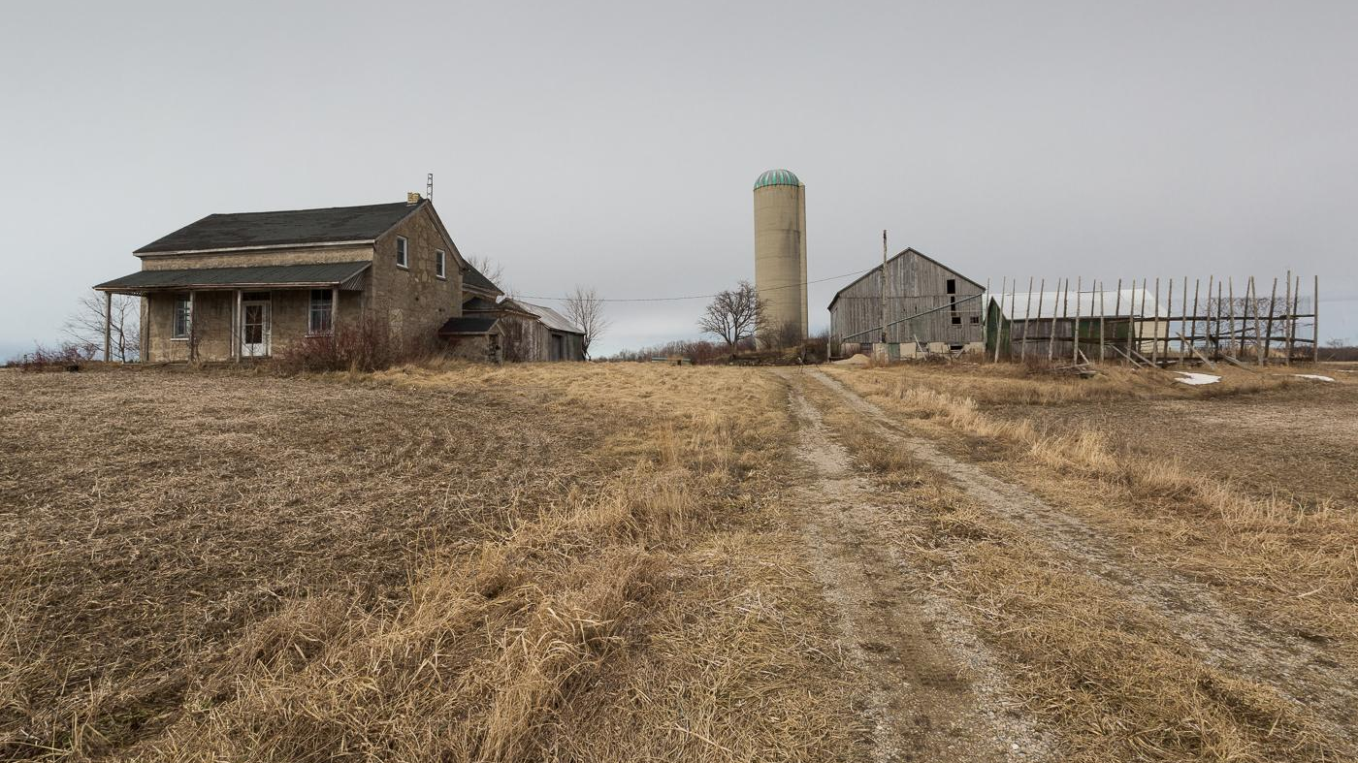
You can’t just scatter seeds and hope — growth takes care and planning. Even rich soil turns barren without care.
Christine Croucher | abandoned farm

Slide 8
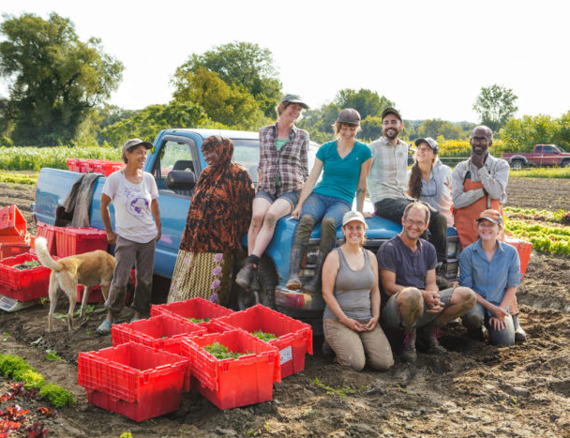
On a co-op farm, success depends on shared responsibility.
If REFEDS were a co-op farm, we all share the responsibilities of tending to the crops standards.
The Digger’s Mirth Collective Farm team. (Photo courtesy of The Intervale Center)
Notes:
"If REFEDS were a co-op farm, the standards would be the crops—planted, nurtured, and harvested by a community that depends on them to thrive."
Over the last 20 years, REFEDS has cultivated a rich field of specifications—identity assurance frameworks, entity categories, attribute schemas, and operational profiles. But just like a co-op farm, the work doesn't fall to one person. It’s a community effort. So who tends these crops?
🌱 The Working Groups
These are the farmers in the field—drafting new specs, debating the best way to grow them, weeding out inconsistencies, and checking in season after season to make sure they’re still producing what the community needs.
🚜 Federation Operators
They’re the regional growers—adapting the standards to local conditions, implementing them, and reporting back on how well they grow. They keep the ecosystem practical and grounded.
🐝 Community Contributors
Think of them as pollinators—people who drop in with ideas, questions, or bug reports. They might not be on every working group, but their participation keeps the system vibrant and healthy.

Slide 9
So… what if we thought of it that way?
Who maintains the standards we all use today?
Who pays for that maintenance?
How do we ensure this work is sustainable and responsive to our needs?
Working groups, community volunteers, federation staff, REFEDS coordination.
Mostly soft funding, in-kind contributions, occasional project grants — often invisible and under-resourced.
This starts to look and feel a lot like operating a shared service.

Slide 10
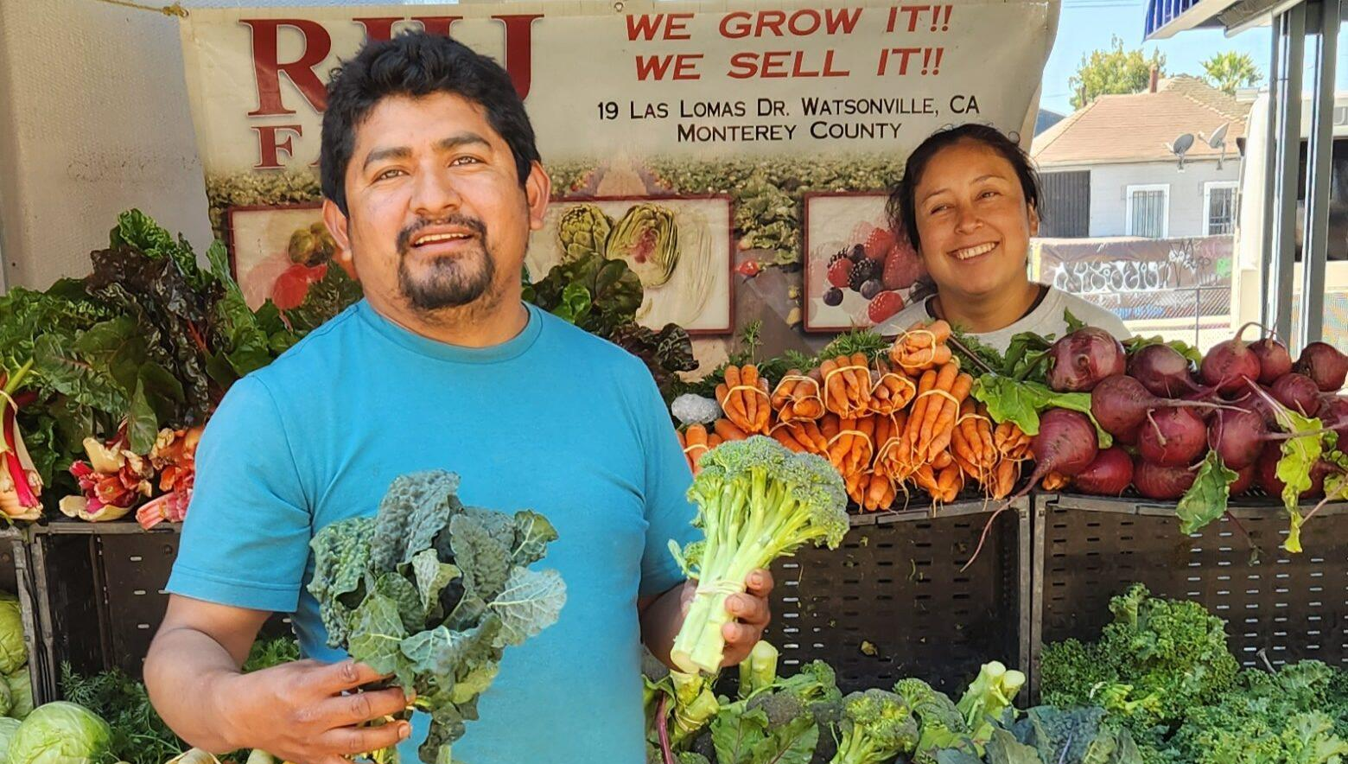
We should think of standards curation much the same way we do with service delivery. If we do, how might we change the approach we take to curate standards today?

