Slide 2
eduGAIN eduGAIN Policy Framework is updated!
The update is based on the Whitepaper: eduGAIN Futures WG recommendations (https://wiki.geant.org/x/OQAtEQ) and applies since January 2024
eduGAIN Constitution has been changed, therefore all members will need to sign the updated eduGAIN Declaration
Further information will be sent out later this year
Send any question about this process to support@edugain.org
The current version of the policy framework is published at https://edugain.org/governance/
The page is not yet fully updated but the current Constitution and Steering Committee Terms of Reference are published

Slide 3
The governance of eduGAIN has changed
eduGAIN Steering Group is replaced by
eduGAIN Assembly
1 delegate and 1 deputy of all member federations
eduGAIN Steering Committee
4 member representatives from eduGAIN Assembly
2 broader community representatives
eduGAIN Service Owner (ex-officio)
eduGAIN Executive Committee
Representatives from organisations that funds eduGAIN operations
eduGAIN Service Team and Secretariat
Daily operations of eduGAIN

Slide 4
Current eduGAIN Steering Committee members
Pål Axelsson (Member SWAMID, 2024-2025, chair)
Thijs Kinkhorst (Member SURFconext, 2024-2025)
Francisca Martin-Vergara (Community, 2024-2025)
Jonathan Eagan (Member CAF, 2024)
Muhammad Farhan Sjaugi (Member SIFULAN, 2024)
Slavek Licehammer (Community, 2024)
Davide Vaghetti (Ex-officio, vice-chair)
The steering committee is appointed by the eduGAIN Assembly with a staggered 2 year term

Slide 5
eduGAIN Futures report - Current progress of recommendations
3.1 - New governance model is implemented
3.3 - Candidate Process is improved (https://wiki.geant.org/x/UIBwG)
eduGAIN Steering Committee focus on the eduGAIN Futures whitepaper
3.2 - together with 1.1
Ongoing discussions on how to maintain federation infromation such as federation policy updates and contact information
The REFEDS WG Metadata about federations may support the recommendation
1.2 - Filtering out single entities in eduGAIN is sensitive and discussions about criterias has started
eduGAIN Steering Committee focus on the eduGAIN Futures whitepaper (https://wiki.geant.org/x/OQAtEQ)
eduGAIN Steering may create working groups to discuss individual recommendations

Slide 6
eduGAIN growth metrics
Entities to Federations Ratio

Slide 7
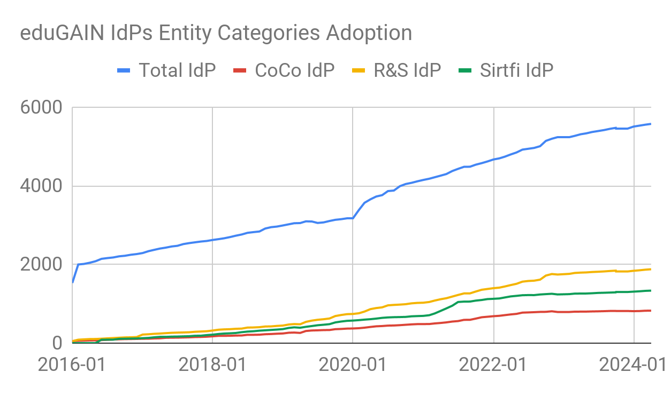

Slide 8
