Slide 1
SimpleSAMLphp
REFEDs #48 @TNC2024

Slide 2
SimpleSAMLphp - quick overview
SAML IdP/SP and OIDC OP/RP, and proxy
18+ Contributed modules (additional protocols, MFA, consent, user & management interfaces)
Started at FEIDE/UNINETT (now SIKT)
Second most used SP/IdP product in eduGAIN (~1k deployments)
‘Core’ product in several national federations
Many deployments in other sectors
Active development since 2009 (SSP 1.0)
~ 3-4 releases per year
The latest release is SimpleSAMLphp 2.2.2

Slide 3
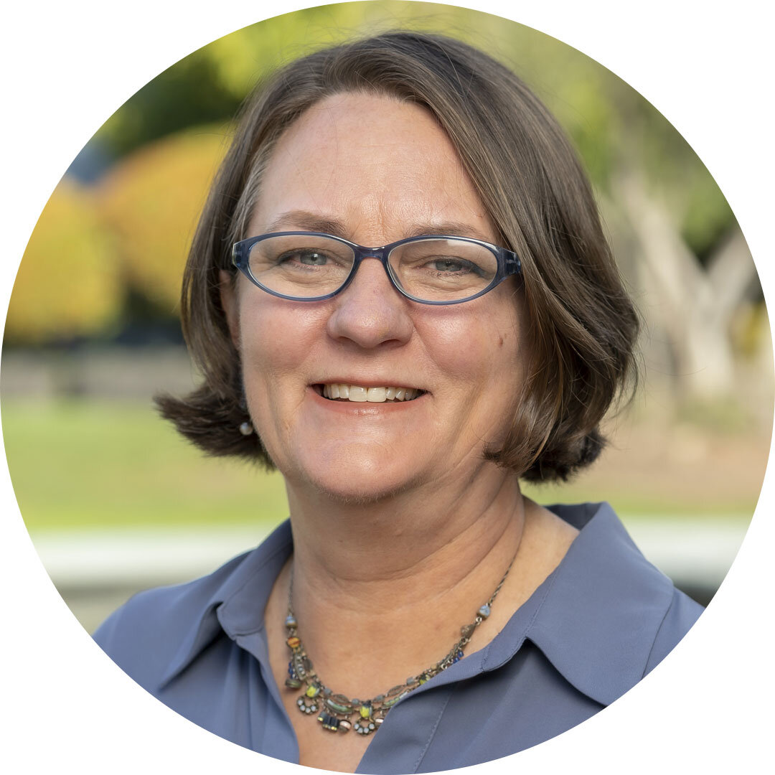
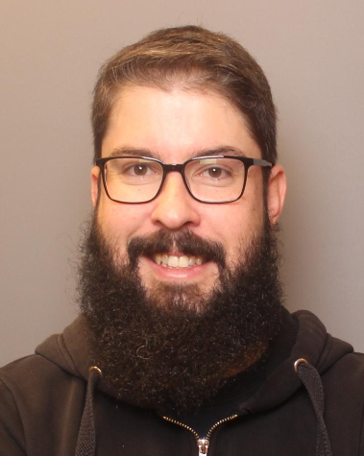
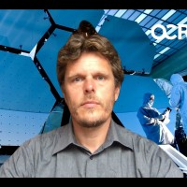
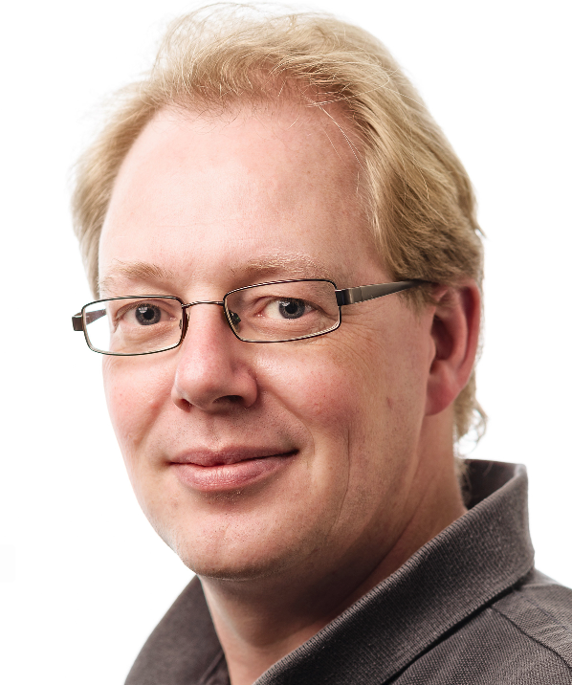
SimpleSAMLphp - changing governance
UNINETT announced it will end direct support for SSP
SSP board was formed to transition SSP and its ‘assets’ into a new governance
And safeguard continued maintenance and development
Introducing the board: Dedra Chamberlin, Jaime Pérez, Jan Meijer (chair), Marina Adomeit, Niels van Dijk

Slide 4
SimpleSAMLphp - work so far
2023
SSP moved from UNINETT into ‘The Commons Conservancy’
SSP website moved from UNINETT infra to Github pages
2024
Hired first lead maintainer, Ben Martin “MonkeyIQ” beginning of 2024
make sure stuff is integrated, issues are resolved, decisions made
Strategy and funding strategy written and published
https://github.com/simplesamlphp/governance/blob/main/docs/SimpleSAMLphp%20Strategy.md

Slide 5
SimpleSAMLphp - contributions
We welcome contributions of any kind, both financial as well as in kind.
If you want to contribute financially, we kindly suggest the following yearly contribution levels:
Platinum - euro 30.000 and above
Gold - euro 20.000
Silver - euro 10.000
Bronze - euro 5000 and below
Please know we can send formal invoices (https://github.com/simplesamlphp/governance/blob/main/docs/SimpleSAMLphp%20-%20Funding%20Solicitation.md)
Many thanks to sponsors SIKT.no and Cirrus Identity

