Slide 1
Australian Access Federation REFEDS Update June 2024
JOHN SCULLEN
HEAD, PROJECTS AND MANAGED SERVICES

Slide 2
Agenda
Updates
Support
Dev and Security
ORCID Consortium
Trust and identity for research
What’s next?

Slide 3
Support
Rolling out support for new(ish) entity categories (ECs)
REFEDS MFA for Azure AD enterprise IdPs (about half of AAF subscribers) when they confirm compliance with requirements
RAF
Updates to Validator (validator.aaf.edu.au) to support new ECs
Customer roadshows
Stay in touch – remind/inform about AAF
Understand new customer challenges
Shibboleth 5 upgrades
70% of fleet will be done by 1 September 2024
Rapid IdP
Simplifies upgrades and deployment of new ECs
More time for proactive work
Notes:
RAF – will probably push people straight to v2 if they want to use RAF
Need to update Validator app so it understands and can display the new entity categories (REFEDS MFA, RAF etc)
Rapid IdP makes it really easy to push out updates. Everyone on Rapid IdP will be updated to v5. It will probably take another 3 years to coerce the subscribers still running their own IdP to upgrade.

Slide 4
Development and security
Disaster recovery
H1 2024: define objectives, re-engineer to support targets and test
Recover time objective (RTO) = 8 hours
Recovery point objective (RPO) = 4 hours
Offsite backup review following UniSuper’s incident: https://cloud.google.com/blog/products/infrastructure/details-of-google-cloud-gcve-incident
AWS Well-Architected review
Notes:
Exponentially more engineering effort required to reduce RTO (recovery time objective) and RPO (point objective) numbers. This seemed like a good balance between performance and effort.
Test was recovered in 3 hours with no data loss.
Next time we’ll go wide and include the communications, not just technical recovery.
Unisuper – a missing parameter triggered deletion of the entire Google Cloud Platform tenancy. Reviewing and testing our secondary backup strategy will be the next thing we tackle to ensure we can recover should something like this occur within AWS.
Well-archticted review to confirm our configuration meets AWS best practice. Did one last year. Aiming for further improvement

Slide 5
Development and security
Penetration testing
CILogon now running production instance in AWS Sydney
Pen test on CILogon (and COmanage)
COmanage Registry v4.3.3 mitigates issues
2024-04-30 Registry Advisory has details (https://spaces.at.internet2.edu/display/COmanage/2024-04-30+Registry+Advisory)
Notes:
CILogon deployed to AWS Sydney and all AU customers running from there now
AAF commissioned a pen test of the AU CILogon instance. Findings for both CILogon and COmanage. We shared the COmanage findings back to the COmanage team and these vulnerabilities were fixed in v4.3.3

Slide 6
Development and security
H2 2024 plans
SOC integration
End user devices done
AWS infrastructure integration next
SAML proxy for services that can only deal with a single IdP?
Service Catalogue?
Gradually aligning with ISO 27001
Notes:
Security – feeding logs from AWS environments into SOC service is the next priority (endpoints are already sorted)
SAML proxy and service catalogue bubbling to the top of the priority list. SAML proxy needed for service that assume one and only one IdP (AWS Cognito and APNIC are two examples)

Slide 7
ORCID Consortium
National PIDs Strategy and Roadmap
100% of Australian members have now integrated at least one system
National Imaging Facility (NIF)
PIDs to link usage of instruments and facilities with research outputs

Slide 8
Trust and identity for research
AAF is now officially part of the Australian Government’s National Collaborative Research Infrastructure Strategy (NCRIS) and recognised as a national capability
https://www.education.gov.au/national-research-infrastructure/funded-research-infrastructure-projects
Major activities
Incubator projects
Policy framework for T&I
Cyber security action plan
Notes:
- Only 2 organisations added to NCRIS since inception in 2004

Slide 9
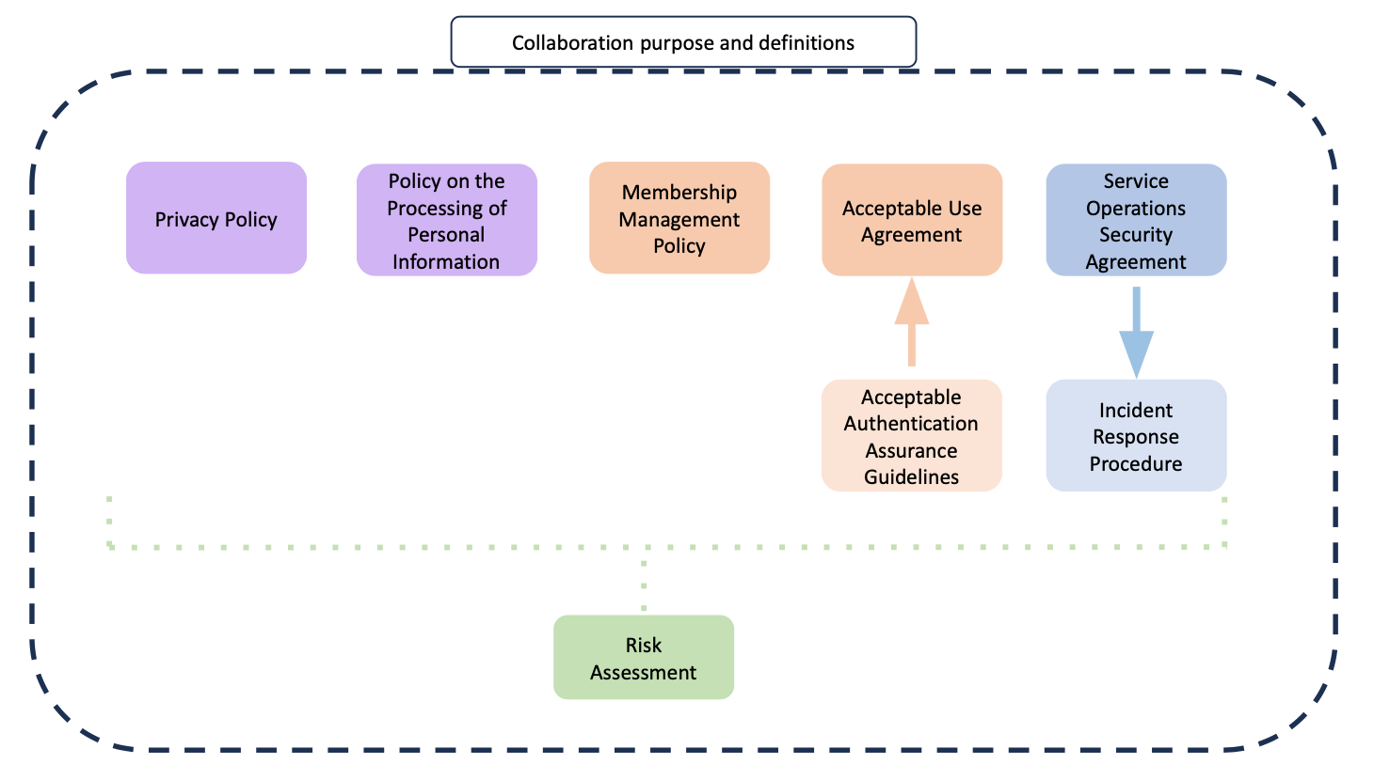
Trust and identity for research
Trust and Identity Policy
Localise AARC Policy Development Kit
Recommended restructuring the document set
Feedback to AARC TREE project
Notes:
- AARC Policy Development Kit: Working on creating the 5 policies in the top row and modify language to match Australian terminology.
Trying to simplify the documents to make them more understandable and less daunting for research communities

Slide 10
Trust and identity for research
Projects
GUARDIANS (Genomics Uplift for Australia through Research Data Infrastructure At National Scale)
Success criteria:
Deployed identity and access management system connected to other sub-projects
Support single sign-on with institutional credentials
Authenticate users not affiliated with AAF, including international researchers
Supported standard authorisation mechanisms
CADRE
Discover and apply for social science datasets
Pawsey Supercomputing Research Centre
Explore AAF authentication for command line tools
National Imaging Facility (NIF)
Use PIDs to connect instrument usage with research outputs and outcomes
Notes:
GUARDIANS project kicking off (something along the lines of Elixir) to enable human genomic data sharing
There are other incubators but these are the two most advanced – I can’t find details on the others anywhere

Slide 11
Challenges
“AAF is great, but what do we do about the people that aren’t AAF subscribers?”
30% to 60% coverage within research communities
A problem for 100% of research communities
Notes:
- The biggest issue is finding a way to bring non-AAF researchers into the community.
- Multi-faceted challenge: technology, process, business model, marketing
- As we’ve concentrated more on research communities, AAF has less coverage of the targe audience

Slide 12
Any questions?
Visit: aaf.edu.au Email: enquiries@aaf.edu.au

