Slide 1
REFEDS Survey 2022

Slide 2
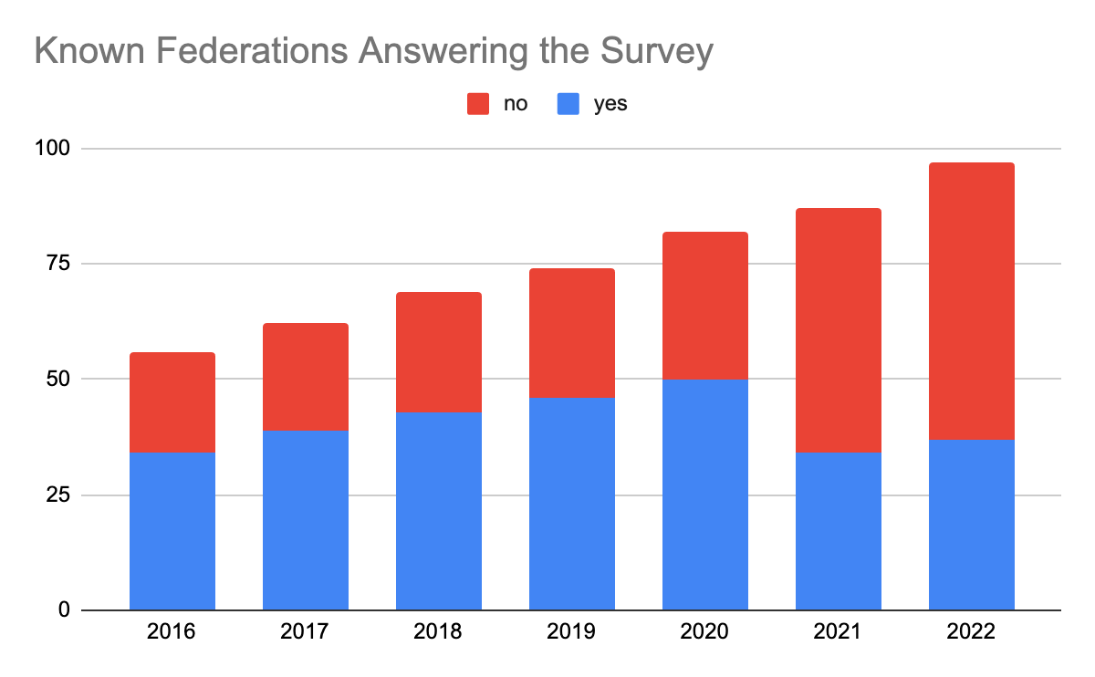
2015 – 26 out of 56 responded
2016 – 33 out of 66 responded
2017 – 38 out of 69 responded
2018 – 43 out of 74 responded
2019 – 45 out of 82 responded
2020 - 50 out of 86 responded
2021 – 33 out of 87 responded
2022 - 37 out of 95 responded
Survey is no longer viable - suggest this will be the last year

Slide 3
“New” Federations in 2022
eduID.ng – Nigeria
eduID.africa – Africa
LIFE – Lebanon
FIEL – Latin America
Azscience.net – Azerbaijan
MAREN – Malawi
TigerFed – Bangladesh
SomaliREN Identity Federation - Somalia

Slide 4
Operational Data

Slide 5
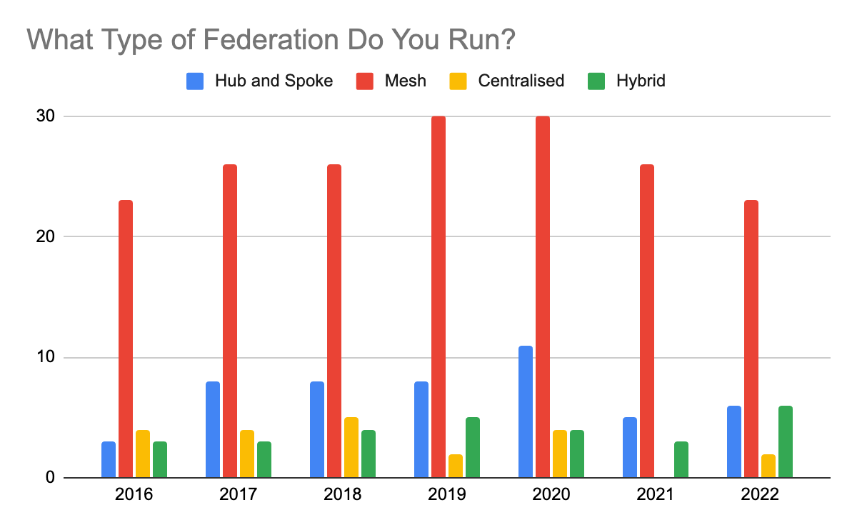
What type of federation do you run? Difficult to tell if these results are in anyway statistically relevant
Notes:
All the new federations declared a different approach

Slide 6
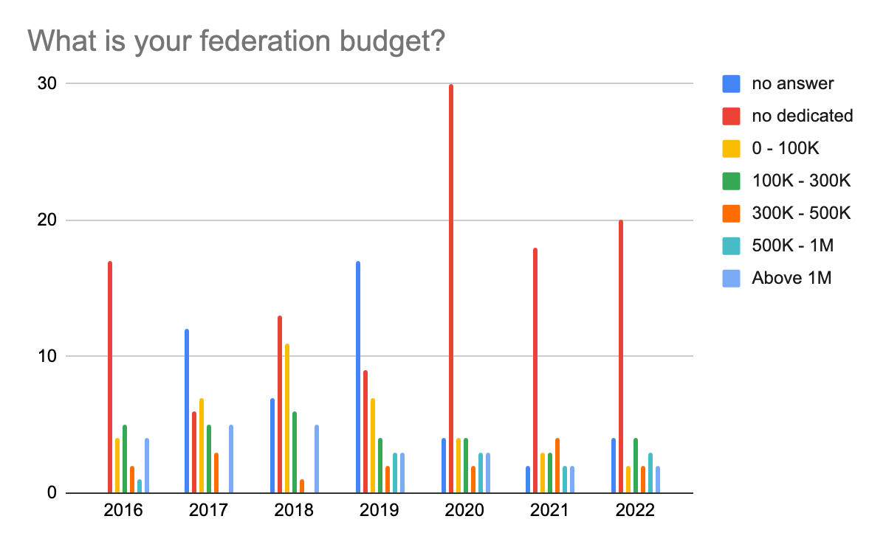
Budget: The trend towards no dedicated budget for the federation continues

Slide 7
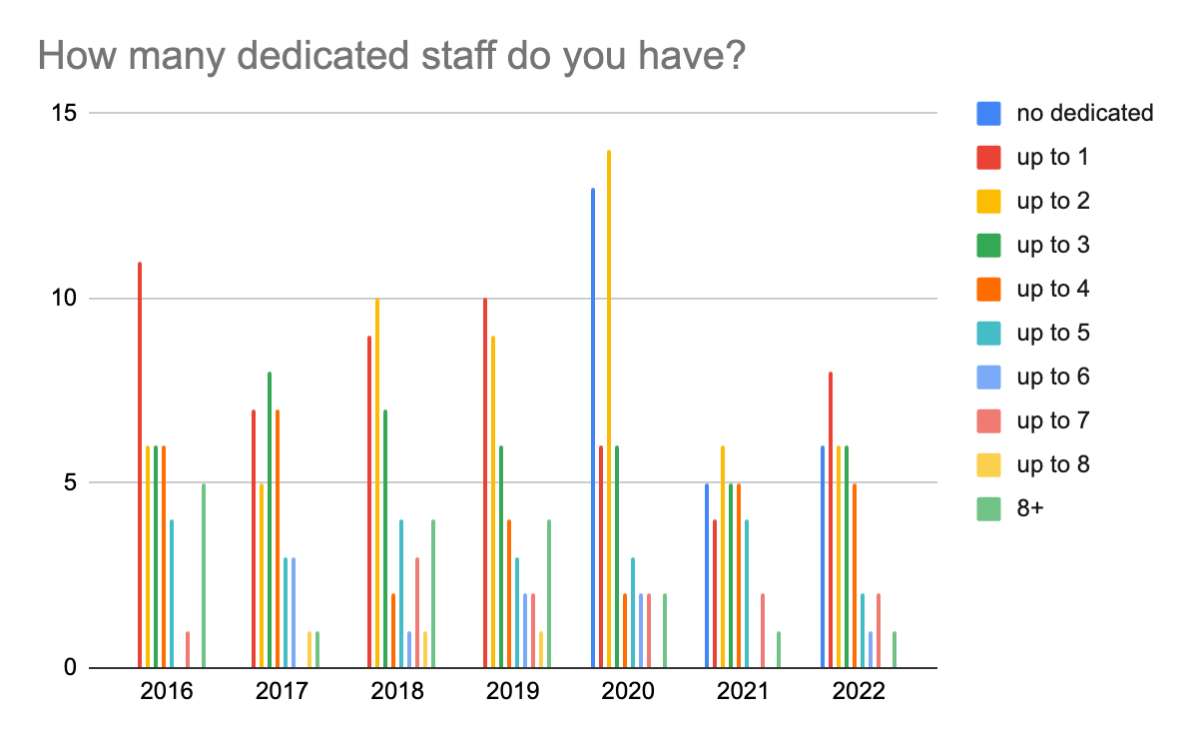
Staffing: Trend towards low staffing continues

Slide 8
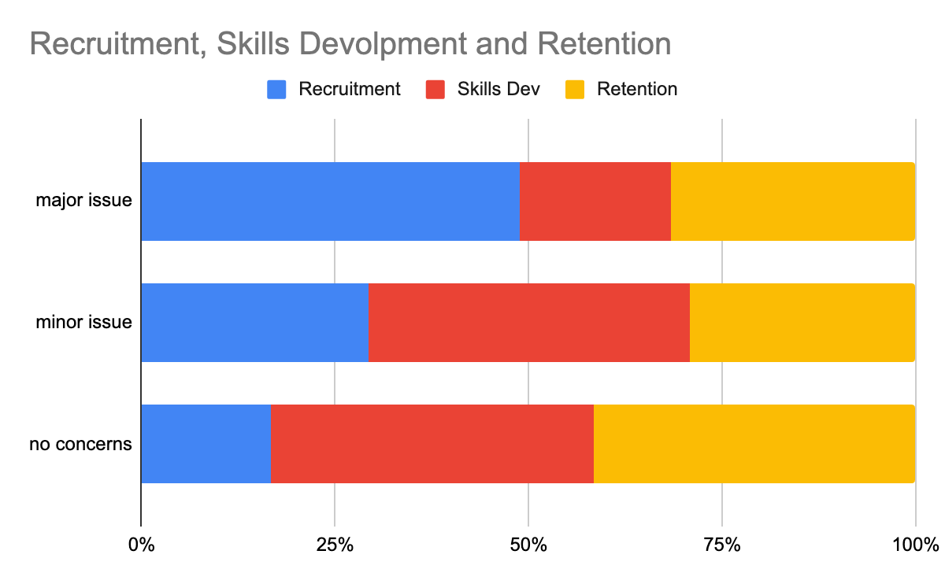
Staffing:
Recruitment seen as the strongest challenge with skills development and retention less of an issue this year

Slide 9
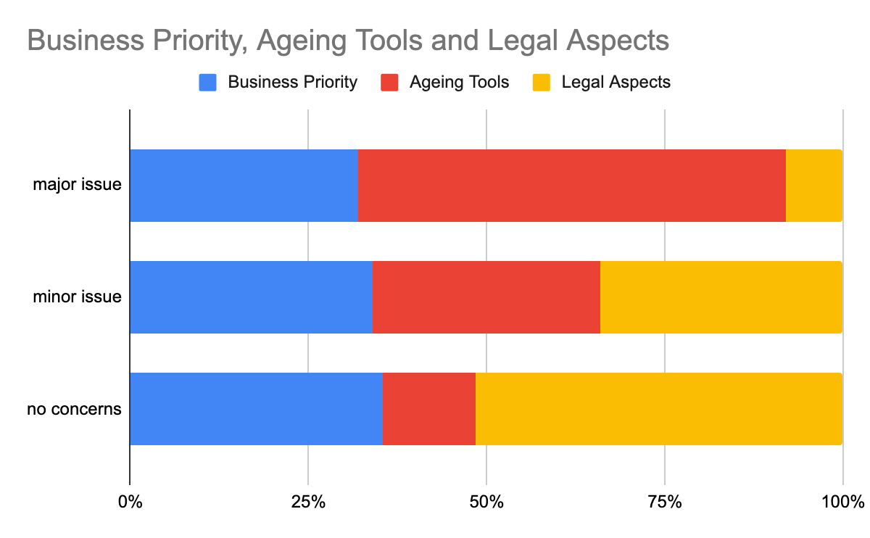

Slide 10
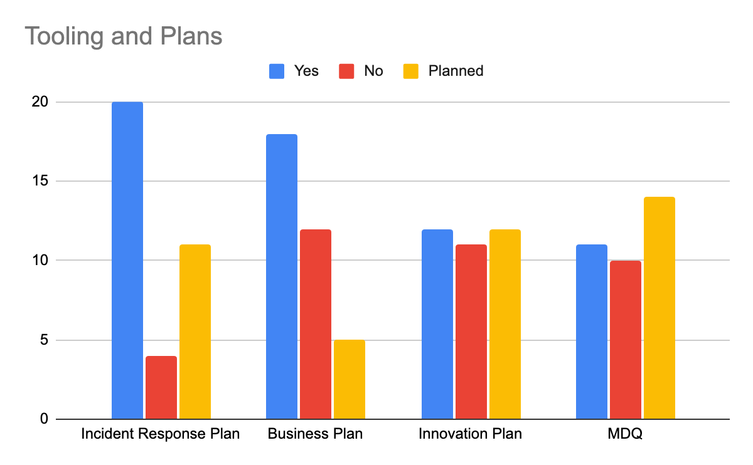
Planning approaches and strategies: Federations having an incident response plan is becoming “the norm”

Slide 11
Technology and Standards Support – Survey Answers

Slide 12
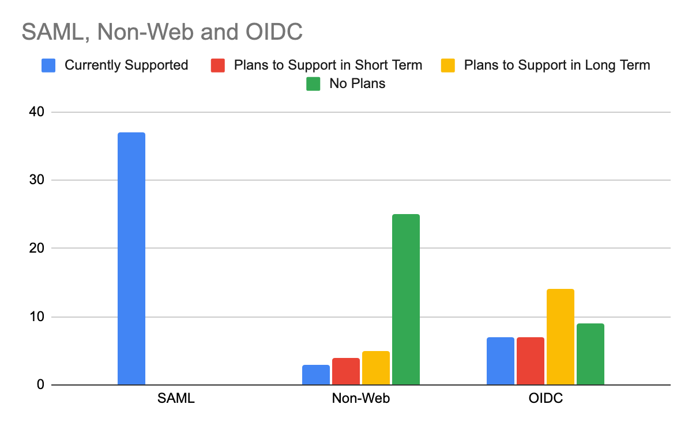
Responses fairly unchanged – we remain a predominantly SAML infrastructure

Slide 13
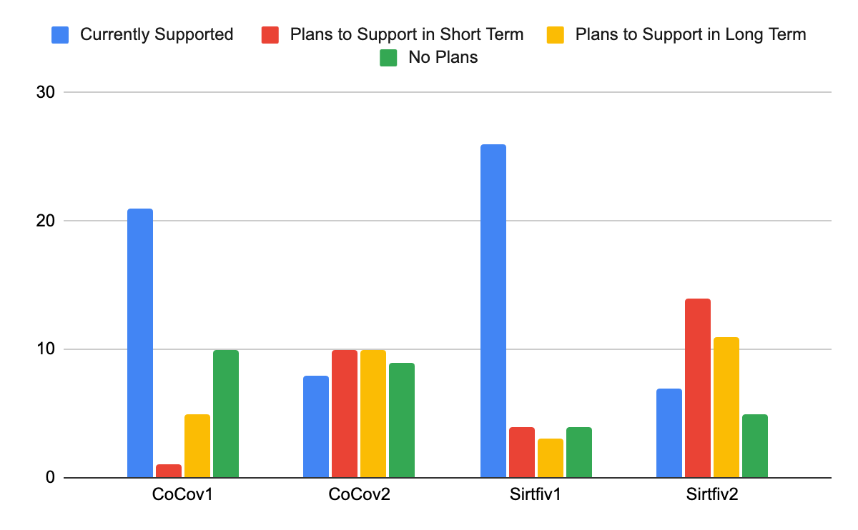
Support for Standards – CoCo and Sirtfi

Slide 14
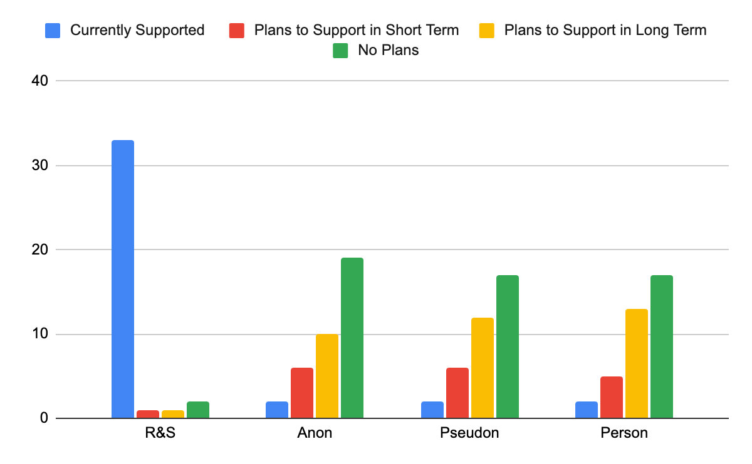
Support for Standards – Access Entity Categories

Slide 15
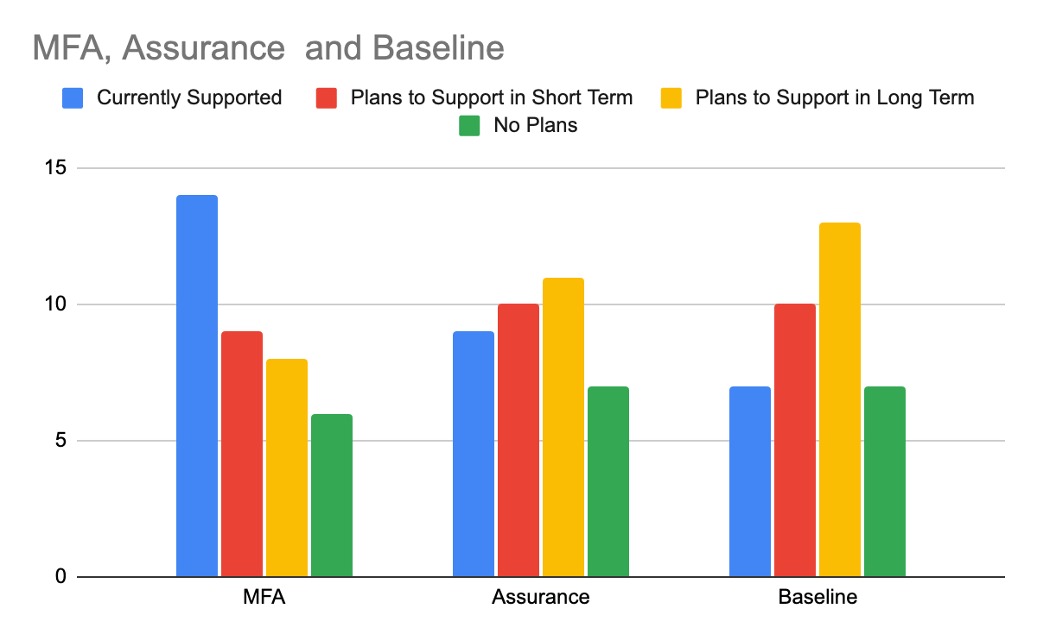
Support for Standards – Assurance and Baseline

Slide 16
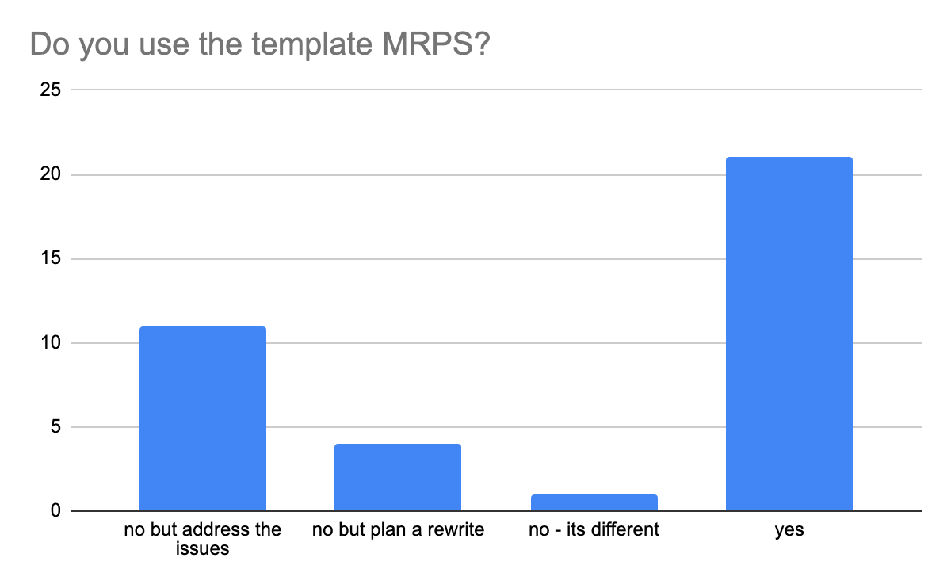
Support for Standards – MRPS

Slide 17
Improvement Plans
renew webportal
knowledge and talent in the field at and all time low
moving to idp-as-a-service
want to do all the standards "at once" - it's easier
a few mentions of CoCo v2, Sirtfi v2, RAF
no plans due to team size
webauthN

Slide 18
Technology and Standards Support – Metadata Analysis

Slide 19
Growth is fairly static compared to eduGAIN growth – only Sirtfiv1 has shown improvement (55% - 60% of participants supporting)
Research and Scholarship
2017: 24
2018: 30
CoCov1
2017: 18
2018: 22
Sirtfiv1
2017: 18
2018: 27
2019: 38
2019: 27
2019: 33
2020: 43
2020: 27
2020: 37
2021: 47
2021: 30
2021: 41
2022: 51
2022: 31
2022: 47
CoCov2
2022: 4
Sirtfiv2
2022: 7
Support for Specifications at federation level as seen in metadata
* Support defined as having 1 or more entity with the tag
Notes:
Support means they have entities that use these categories in metadata in edugain
60% R&S up from 56% in 2019
38% CoCo – down
52% Sirtfi up from 48%

Slide 20
Increase in adoption of R&S for IdPs continues to track (we should be at 100% by 2036…)
R&S IdP
2016: 147 – 6.6% of total (2235)
2017: 294 – 11.4% of total (2580)
2018: 442 – 14.8% of total (2970)
R&S SP
2016: 125 – 9% of total (1384)
2017: 173 – 9.7% of total (1780)
2018: 208 – 8.9% of total (2332)
2019: 727 - 23% of total (3163)
2020: 1057 – 25% of total (4189)
2021: 1488 –30% of total (4818)
2019: 242 - 9% of total (2668)
2020: 270 – 8.5% of total (3195)
2021: 314 –8.8% of total (3534)
2022:1799 – 34% of total (5319)
2022: 351 - 9.7% of total (3594)
Notes:
Big increase in number of IdPs in eduGAIN but new IdPs are not supporting R&S
IdPs
2016 – 2017: 15% increase
2017 – 2018: 15% increase
2018 – 2019: 6% increase
2019 – 2020: 32% increase
SPs
2016 – 2017: 12% increase
2017 – 2018: 31% increase
2018 – 2019: 14% increase
2019 – 2020: 20% increase

Slide 21
Slight SP increase, poor adoption of v2
CoCo IdP
2016: 103 – 4.6% of total (2235)
2017: 156 – 6% of total (2580)
2018: 243 – 8.2% of total (2970)
CoCo SP
2016: 103 – 7.4% of total (1384)
2017: 130 – 7.3% of total (1780)
2018: 170 – 7.3% of total (2332)
2019: 364 - 11.5% of total (3163)
2020: 489 – 11.6% of total (4189)
2021: 733 – 15% of total (4818)
2019: 198 - 7.4% of total (2668)
2020: 206 – 6.4% of total (3195)
2021: 233 – 6.6%of total (3534)
CoCov2 IdP
CoCov2 SP
2022: 802 – 15% of total (5319)
2022: 260: 7.2% of total (3594)
2022: 47 – 0.9% of total
2022: 16 – 0.4% of total

Slide 22
Fairly static – apart from Sirtfi1 SPs
Sirtfi IdP
2016: 113 – 5% of total (2235)
2017: 189 – 7.3% of total (2580)
2018: 355 – 12% of total (2970)
Sirtfi SP
2016: 3 – 0.2% of total (1384)
2017: 14 – 0.8% of total (1780)
2018: 131 – 5.6% of total (2332)
2019: 555 - 17.5% of total (3163)
2020: 719 – 17.1% of total (4189)
2021: 1199 – 24.8% of total (4818)
2019: 227 - 8.5% of total (2668)
2020: 318 – 10% of total (3195)
2021: 1681 - 47% of total (3534)
Sirtfi2 IdP
2022: 1799 – 50% of total (3594)
Sirtfi2 SP
2022: 1262 – 23.7% of total (5319)
2022: 13 – 0.2% of total (5319)
2022: 2 - 0.05% of total (3594)

Slide 23
Community Needs

Slide 24
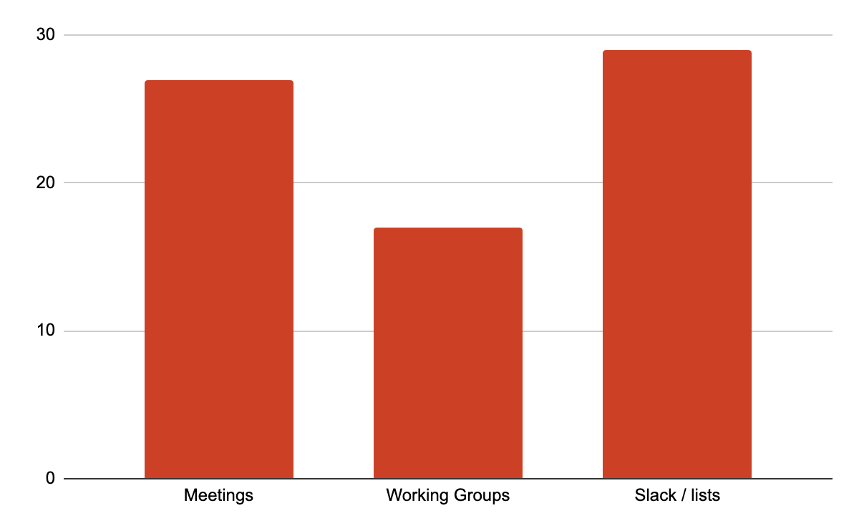
New question – many respondents do not participate in any of the fora available

Slide 25
And why?
I wish I had more time
Staff don't understand how it is organised
Time is limited
GÉANT project competes for time
Timezone issues
Lack of new blood

Slide 26
TOP
3
PRIORITIES
New Sectors / Customers
Uptake
eiDAS / mobility
Training
Audit and Maturity
Improve Tooling
2020
2019
Tool Redevelopment
Security / Sirtfi
MFA / Assurance
OIDC
Documentation and Training
eduID
Tech Upgrade
2021
2022
–
no consistent priorities
Onboarding IdPs
IdP as a Service
Notes:
Focus on n

Slide 27
Proposals for REFEDS
Toolbox for federation operators offering handling of metadata from registration to MDQ service
Focus on the next wave of Identity: Digital wallets and verifiable credentials, password-less auth, focus on supporting global research initiatives and less on campus identity and be less EU focused
More participation in 'other' areas as a community or REFEDS members as amabassadors to other areas like OIDF, digital wallet initiatives, and W3C for browser items come to the forefront of the mind.
Foresight study around AAI
Help on the implementation and control of these standards is missing. Would it be possible to have a working group dedicated to that ?
A list of available services to the community
Survey of joint industry-academia ID collaboration and support status of strong IAL in each federation
Housekeeping - REFEDS already did A LOT of things in the last years, it is probably time to put some order.
Continue to work toward making the standards and specs deployable in the real world -> they have a lot of value, but value is only realized if there is widespread (not necessarily universal) adoption.
We need stronger coordination, clear interoperability expectations and standards, and the enforcement of those expectations in order to fully realize the value/benefit of global R&E identity federations.
Update REFEDS template documents
The recent W3C FedCM news probably need also to have some room in REFEDS...
A new WG for technical implementation of OIDC Federation
Improving MET
Clarifying the relationship and responsibilities between REFEDS and eduGAIN might become increasingly important.
More trainings on advanced features to federation operators

Slide 28
Conclusions
Not enough demand to continue the survey
Federations operate as critical infrastructure but are not funded or resourced as critical infrastructure
Fed Ops seem to be quite apathetic, and focus is on renewing old tools rather than new initiatives
No Significant concerns about federations as a business priority – yet lack of funding and staffing prevalent
No time to commit, but we keep inventing new fora
Fragmentation across federations is at it worst
New standards are not being adopted and there are few plans to adopt
Survey results are highly contradictory

