Slide 1

REFEDS Survey 2019

Slide 2
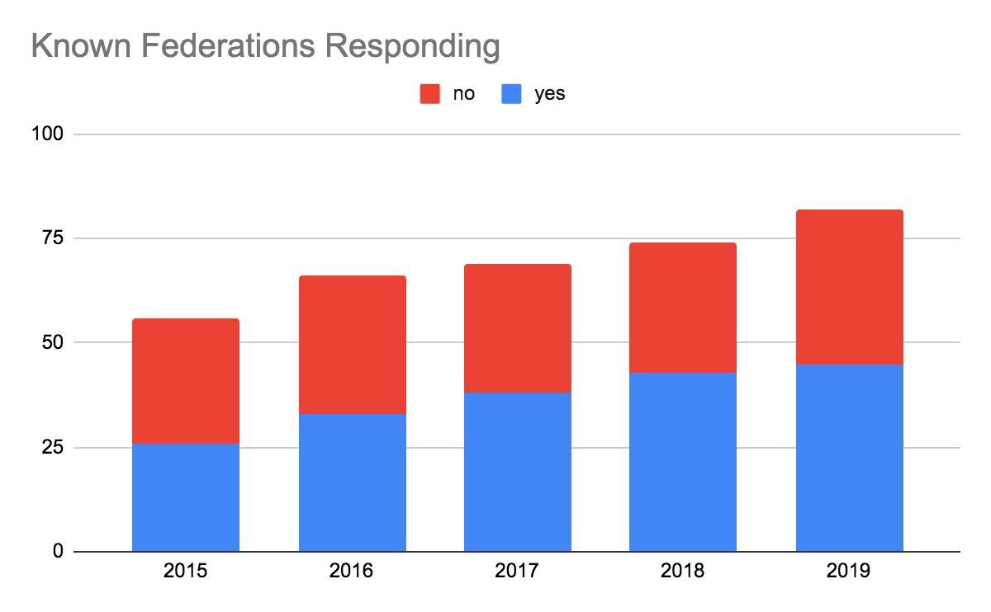
2015 – 26 out of 56 federation responses received
2016 – 33 out of 66 responses received
2017 – 38 out of 69 responses received
2018 – 43 out of 74 responses received
2019 – 45 out of 82 responses received

Slide 3
















Answers from 45 out of 82 known federations
Notes:
Lost: Russia (FEDURUS), Ecuador, Latvia, New Zealand, Oman (OMAN KID), Singapore (6)
New: Sri Lanka, Saudi Arabia, Missouri, Romania, Turkey (5)
Returners: Belgium, Czech Republic, Greece, India (4)
Net gain of 3 federations.
Australia, Brazil, Hungary, Norway, Netherlands, USA, Denmark, South Korea, Hong Kong (Ireland), Lithuania (Austria),
Czech Republic, Germany, Moldova, (New Zealand), France ,Finland, Poland, Spain, UK, Italy, Belgium, (Slovenia)
Croatia, Sweden, Switzerland, Canada, India, Luxembourg, Greece, (Morocco), Japan, Algeria, (Bulgaria), (Mozambique),
(Georgia), (Latvia), Belarus , (Ecuador), Iran, Israel, Portugal, South Africa, Estonia, Armenia, Cyprus, Kyrgyzstan,
Malaysia, (Oman, (OMAN KID)), Oman (OMREN), (Russia (FEDURUS)), Singapore, Uganda, Sri Lanka, Saudi Arabia, Mozambique, Romania, Turkey
Never heard from: Albania, Argentina, Chile, China, China (CSTCloud), Columbia, North Macedonia, Lebanon, Mexico, Montenegro, Peru, Russia (RUNNET), Serbia, Slovakia, Trinidad & Tobago, Ukraine, OpenAthens, Malta, Tajikistan, Indonesia (20)

Slide 4
”New” REFEDS Federations in 2019
LIAF: Sri Lanka (participating in survey)
Maaen: Saudi Arabia (participating in survey)
MOREnet: Mozambique (participating in survey)
Open Athens: Global
RicerkaNet Identity Federation: Malta
TARENA Identity Federation: Tajikistan
CSTCloud: China
Federasi:ID: Indonesia

Slide 5
Operational Data

Slide 6
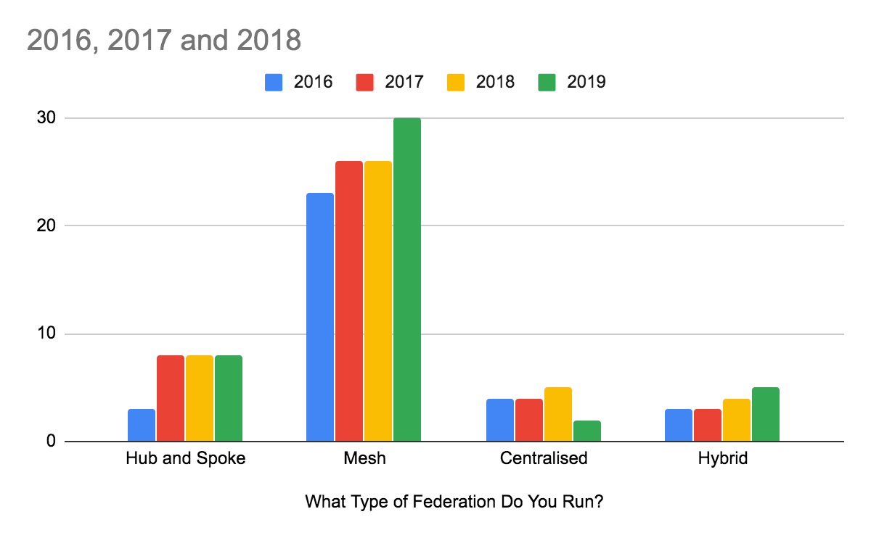
What type of federation do you run?
Small increase in mesh approaches – this may be impacted by answers from some older, established federations this year

Slide 7
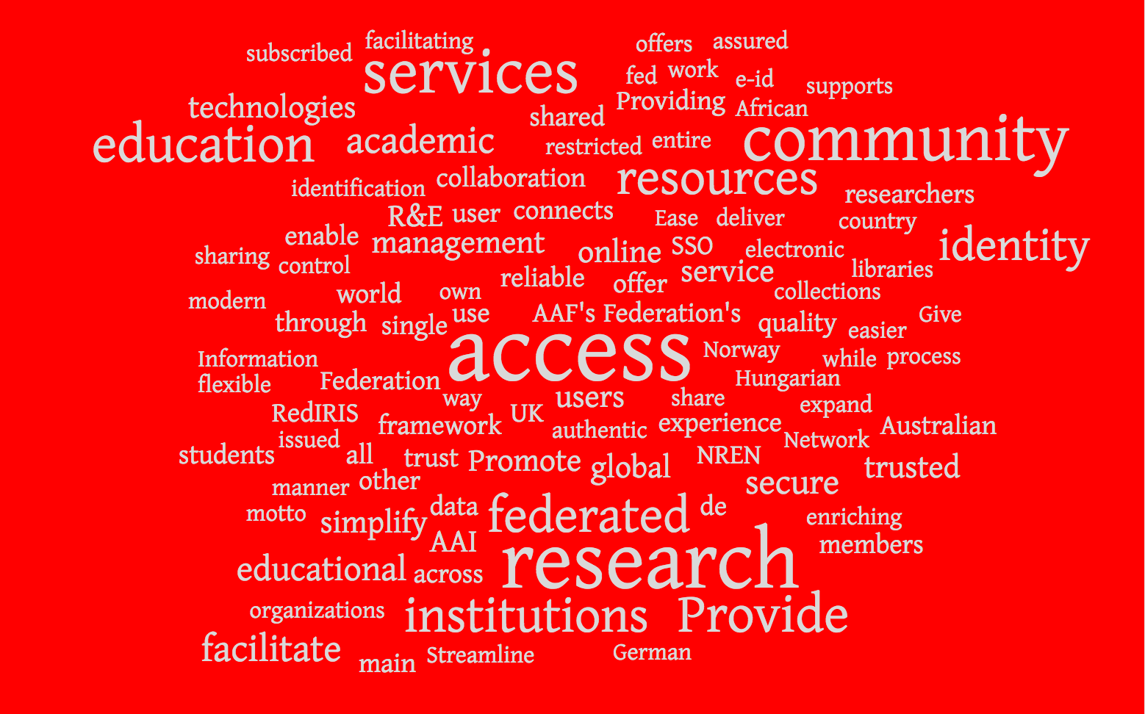
Mission Statement?

Slide 8
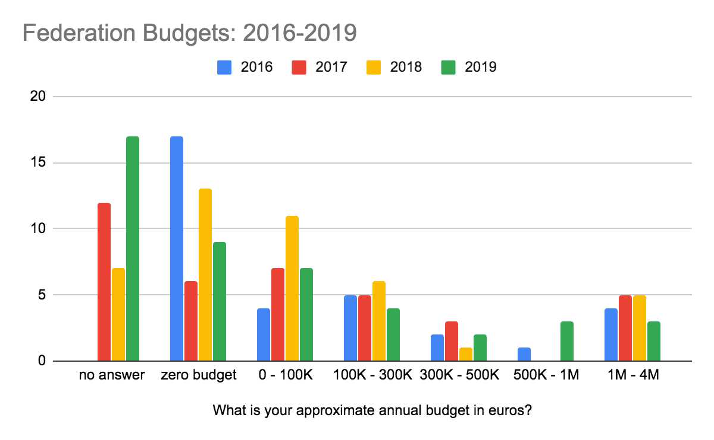
Budgets have remained fairly similar. 73% of federations that responded have less than 100K or do not have an allocated budget for their activity.
Notes:
12 federations did not respond

Slide 9
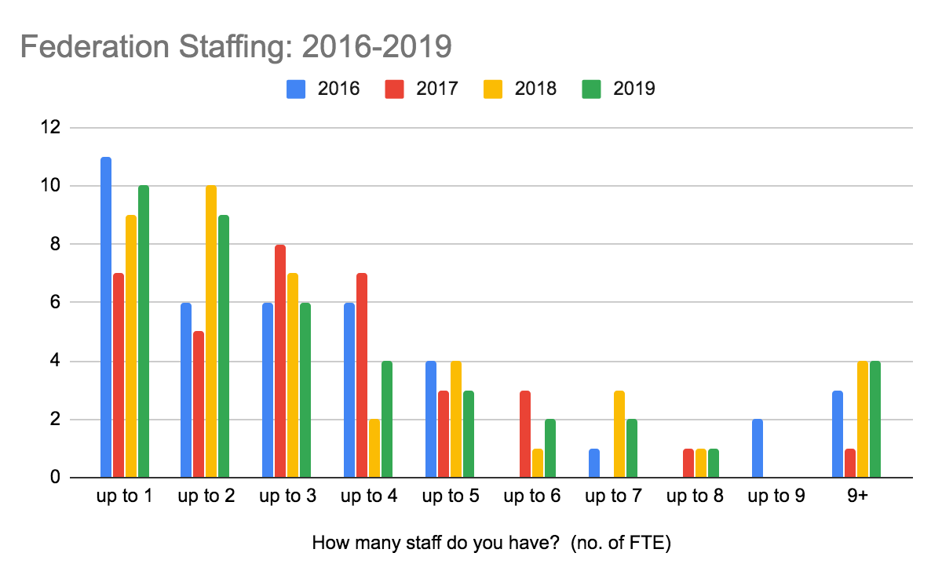
There is a very slight increase in the number of staff working on identity federations – ideal goal would be 3+ for all

Slide 10
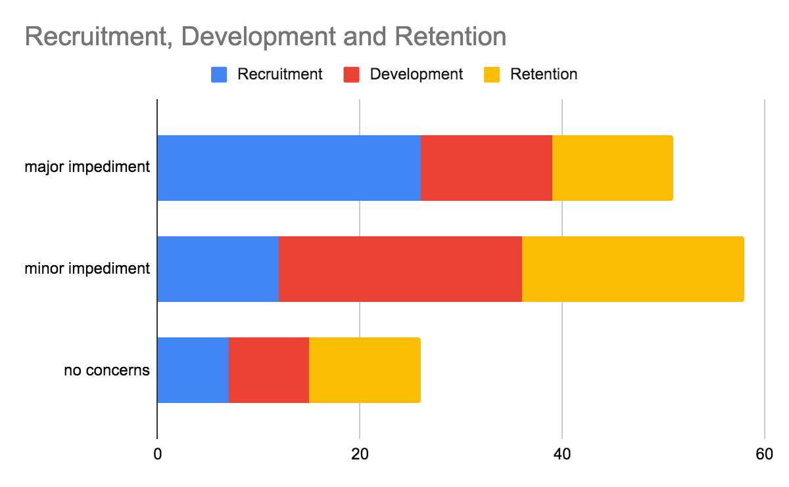
57% of federations that responded see recruitment as a major impediment for federations
Notes:
This is an increase in concern from last year.

Slide 11
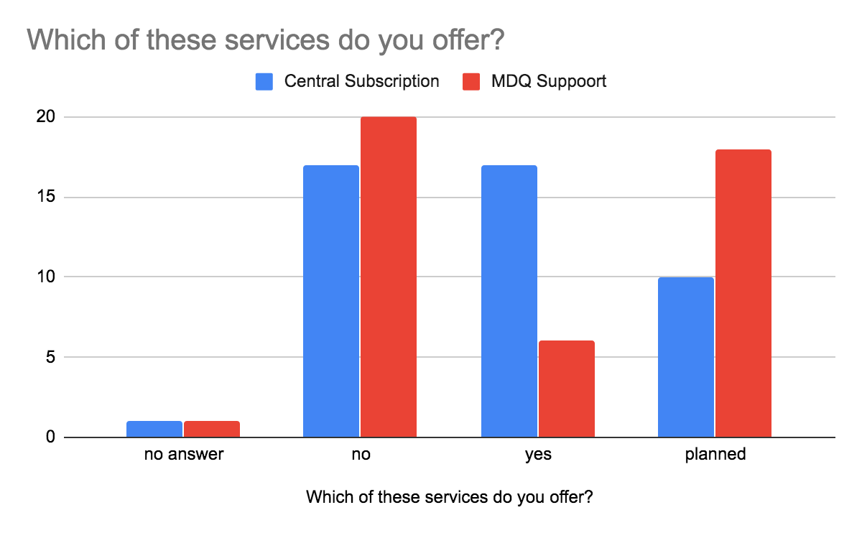
Continued increase in the central subscription service offer, rising interest in MDQ

Slide 12
Technology and Standards Support

Slide 13
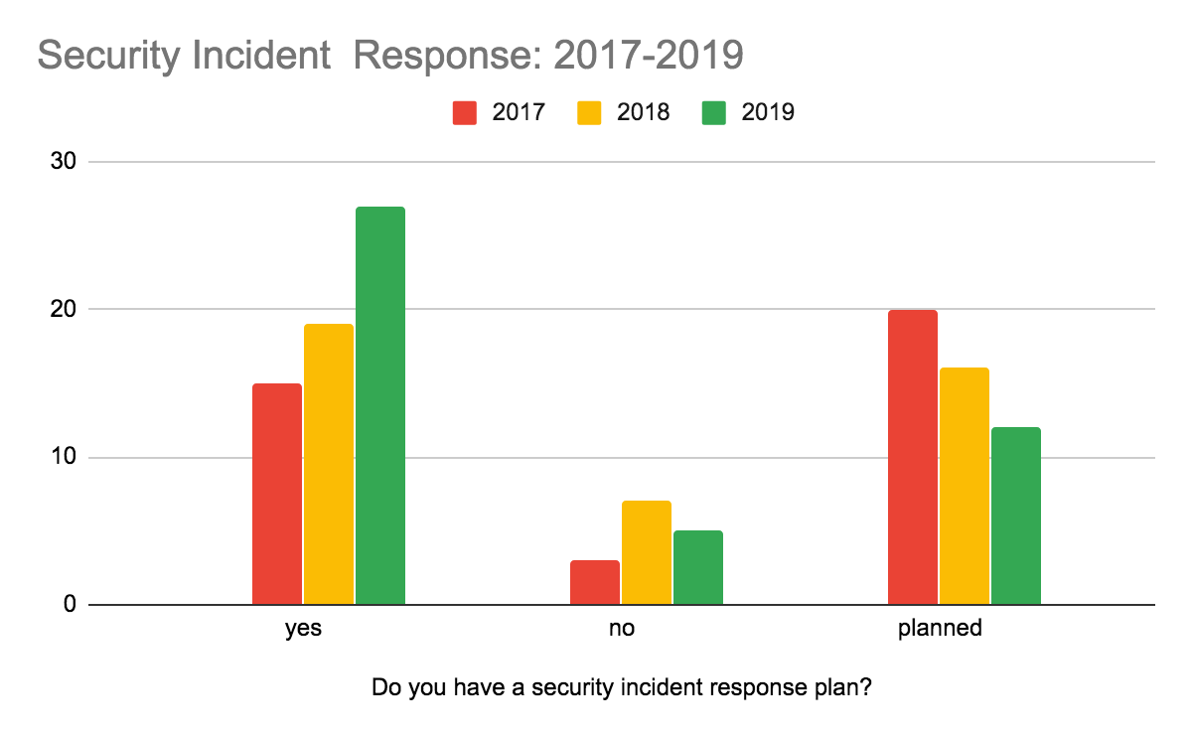
Continued improvement and interest in Incident Response Planning

Slide 14
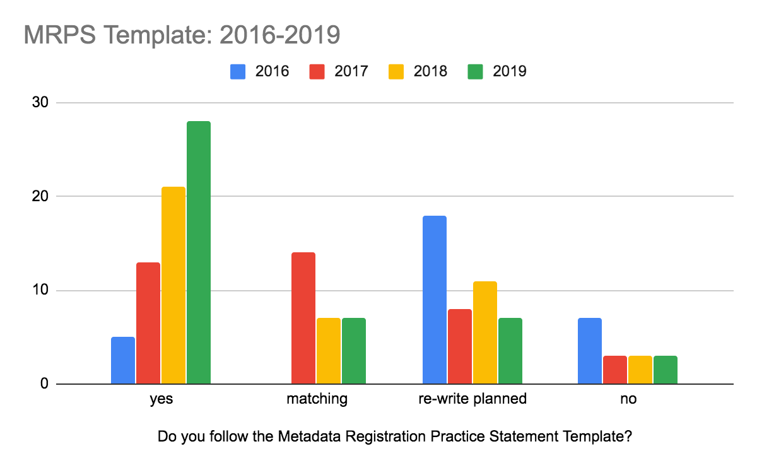
Significant change – the “stick” of eduGAIN Policy worked

Slide 15
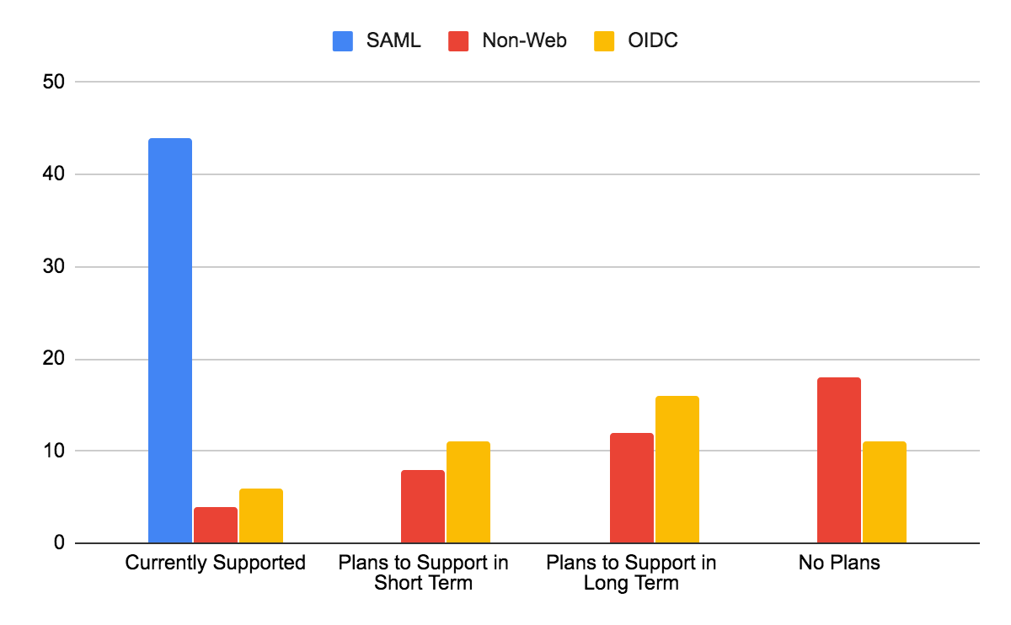
Decreasing interest in non-web, no significant change in OIDC Support

Slide 16
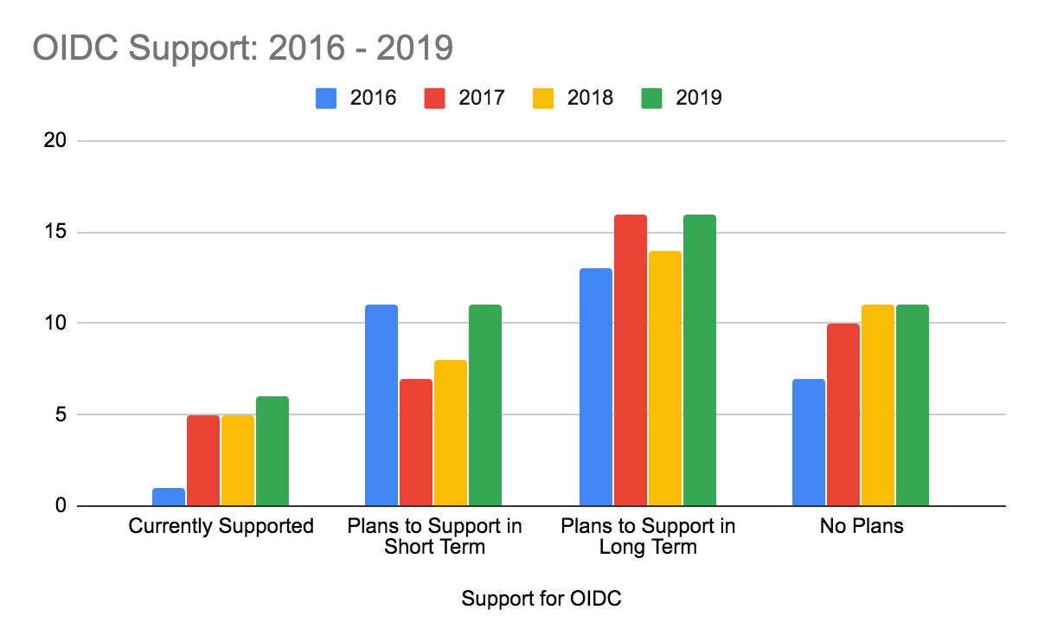

Slide 17
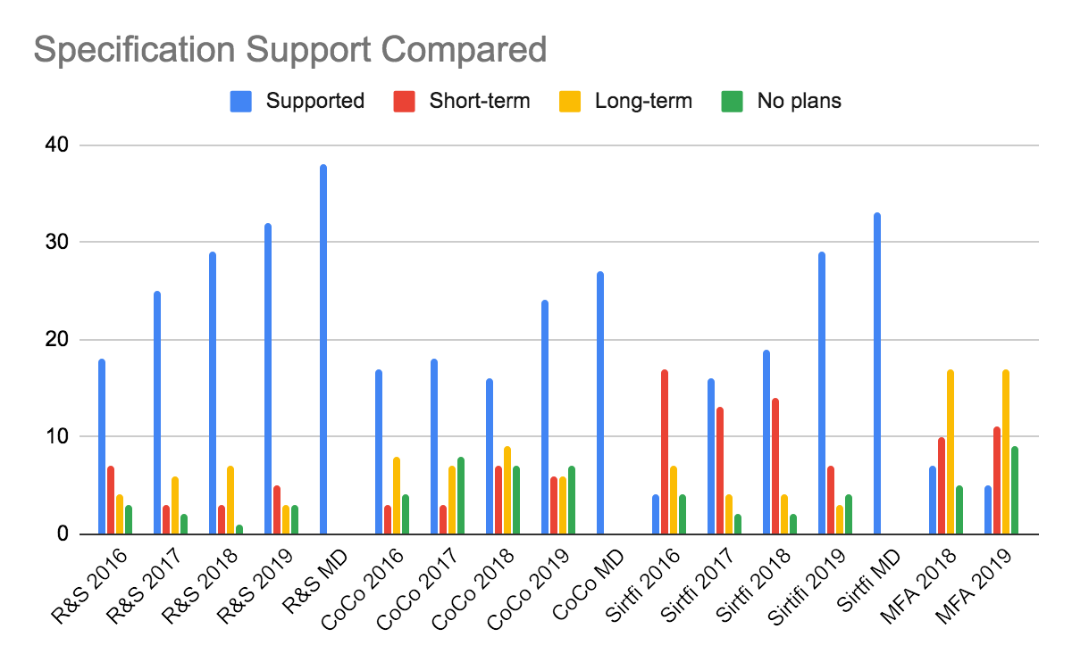

Slide 18
There is steady growth. 56% of eduGAIN members support R&S, 48% support Sirtfi and 40% support CoCo
Research and Scholarship
2017: 24
2018: 30
CoCo
2017: 18
2018: 22
Sirtfi
2017: 18
2018: 27
2019: 38
2019: 27
2019: 33
Support for Specifications at federation level as seen in metadata

Slide 19
Roughly 9% of eduGAIN Service Providers are “R&S”. This has remained consistent
R&S IdP
2016: 147 – 6.6% of total (2235)
2017: 294 – 11.4% of total (2580)
2018: 442 – 14.8% of total (2970)
R&S SP
2016: 125 – 9% of total (1384)
2017: 173 – 9.7% of total (1780)
2018: 208 – 8.9% of total (2332)
2019: 727 - 23% of total (3163)
2019: 242 - 9% of total (2668)

Slide 20
SP adoption of CoCo is not increasing ahead of the rate of new services added
CoCo IdP
2016: 103 – 4.6% of total (2235)
2017: 156 – 6% of total (2580)
2018: 243 – 8.2% of total (2970)
CoCo SP
2016: 103 – 7.4% of total (1384)
2017: 130 – 7.3% of total (1780)
2018: 170 – 7.3% of total (2332)
2019: 364 - 11.5% of total (3163)
2019: 198 - 7.4% of total (2668)

Slide 21
IdPs are adopting at a faster rate than SPs
Sirtfi IdP
2016: 113 – 5% of total (2235)
2017: 189 – 7.3% of total (2580)
2018: 355 – 12% of total (2970)
Sirtfi SP
2016: 3 – 0.2% of total (1384)
2017: 14 – 0.8% of total (1780)
2018: 131 – 5.6% of total (2332)
2019: 555 - 17.5% of total (3163)
2019: 227 - 8.5% of total (2668)

Slide 22
Community Needs

Slide 23
TOP
3
PRIORITIES
OIDC
eduGAIN
Multifactor
Support
Self Service Portals
Training / Support
Operations
Multifactor
OIDC
Promotions / Awareness
Small upgrades / refresh
2017
2018
New Sectors / Customers
Improve Tooling
Documentation and Training
OIDC
Audit and Maturity
2019

Slide 24
Priorities in 2019 | Federations
New sectors / partners / customers | 13
Improve tooling | 11
Documentation and Training | 10
OIDC | 9
Audit / maturity | 8
MFA | 7
Communication and outreach | 7
New Services | 7
Sirtfi | 6
Deployment Support | 3
eduID | 3
RAF | 3
Entity Category Support | 2
Service Catalogue | 2
Monitoring | 2
Discovery | 2
eIDAS | 2
Priorities in 2019 | Federations
Recruitment | 1
ADFS Support | 1
Cloud IdP | 1
WebAuthN | 1
TOTP | 1
MDQ | 1
API Security | 1
MRPS | 1
Full list of Federation Priorities in 2019

Slide 25
Proposals for REFEDS | Mentions
Service Catalogue / MET | 7
SAML-OIDC | 5
Audits / Maturity Analysis / Baseline | 4
Support for new federations / regional support | 4
Training | 4
Best practice for discovery | 4
Entity Categories | 2
More Best Practice | 2
More technical documents / events | 2
Monitoring | 1
Metadata Validation | 1
Cloud IdP | 1
Coordinate eduID efforts | 1
Carry on | 1
More outcomes from WGs | 1
push-MDQ support | 1
Proposals for REFEDS | Mentions
History of advanced federations | 1
CoCov2 | 1
Consensus on the use of idenitifers | 1
Error handling | 1
Interfederation awareness for federations with opt-out policy | 1
Discuss SSI | 1
Provide federation as a service | 1
Phishing Resistant Measurement to be included in REFEDS MFA | 1

