Slide 1
REFEDS Working Group Updates
REFEDS 41, 9 December 2019

Slide 2
WG Terms
The following terms apply to all REFEDS Working Groups (from the REFEDS Participant’s Agreement):
When a working group is agreed, REFEDS Participants will be asked if they wish to participate. Working Groups tend to be small, so consensus can be achieved quickly between participants.
A chair for the group is chosen from the REFEDS Participants.
GEANT association provides facilities for the working group, including meeting support, wiki space, mailing lists and, where appropriate, funding.
An appropriate output from the group is produced. Currently, this is typically a draft white paper or a wiki page.
When the Working Group is in agreement, the chair shares the outputs with the wider REFEDS community with an open period for discussion and comment. This is typically a period of 4 weeks, but may be longer if appropriate.
After this period of time, the REFEDS Steering Committee signs off on the work item. Work is either written up as a formal white paper, left on the wiki but promoted as finished work or occasionally submitted as an Internet Draft.

Slide 3
Assurance
WG Chair: Jule Ziegler
Wiki page: https://wiki.refeds.org/display/GROUPS/Assurance+Working+Group
Description:
Work together with the AARC project to deepen the minimal assurance level recommendation to a profile that is specific enough that it can be self-assessed by home organisations
Develop the differentiated LoA recommendations, taking into account the constraints of the federations and home organisations
Deliver orthogonal profiles that can be additive, e.g., identity proofing separate from credential technology

Slide 4
Assurance
REFEDS Assurance Suite Delivered
REFEDS Assurance Framework (RAF) ver 1.0
https://refeds.org/assurance
REFEDS Single-factor authentication profile (SFA) ver 1.0
https://refeds.org/profile/sfa
REFEDS Multi-factor authentication profile (MFA) ver 1.0 approved in June 2017
https://refeds.org/profile/mfa
… and registered at IANA since Nov. 2019
https://www.iana.org/assignments/loa-profiles/loa-profiles.xhtml

Slide 5
Assurance
The big picture of assurance in REFEDS
Identifiers
ID proofing
Attributes
Authentication
ID is unique, personal and traceable
Low (self-asserted)
Affiliation freshness 1 month
Single-factor authentication
ePPN is unique, personal and traceable
Medium (e.g. postal credential delivery)
Affiliation freshness 1 day
Multi-factor authentication
High
(e.g. F2F)

Slide 6
Assurance
Ongoing Activities
RAF/MFA/SFA have been added to the proposed Security Baseline for NRENs (part of GN4-3 project WP8):
https://docs.google.com/document/d/1DqQpLXHF9buv_7xv0rxw-9bV-04gWVdwBiFr2A1uPBw/edit#heading=h.fz75fog9kojd
Logos for REFEDS assurance suite are underway (including other REFEDS specs)
Discussions about RAF/MFA/SFA entity categories. Leave your rating here: https://doodle.com/poll/e9yxii72d6qfygvw

Slide 7
Entity Category Development
WG Chair: Nicole Harris
Wiki page:
https://wiki.refeds.org/display/GROUPS/Entity+Categories+Development+Working+Group
Description:
Explore the potential development of additional entity categories beyond Research & Scholarship v1 and other additional categories that may arise.
Work has been dormant, but will pick up in 2020 as the Seamless Access “Entity Category and Attribute Bundles Working Group” sends its recommendations to REFEDS

Slide 8
Federation Operators Group (FOG)
WG Chair: Peter Schober
Wiki page: https://wiki.refeds.org/display/GROUPS/FOG
Special membership rules:
Open to Federation Operators as vetted by current members of FOG
Operating rules:
Participants of this list are free to use the information received, but neither the identity nor the affiliation of the source(s), nor that any other participant, may be revealed. If this cannot be ensured, redistribution of any information received requires prior express permission from the source(s).

Slide 9
Federation 2.0
WG Chairs: Judith Bush, Tom Barton
Wiki page: https://wiki.refeds.org/display/GROUPS/Federation+2.0
Description:
WG is following a structured process to gather input from a wide range of information sources and individual perspectives, in order to review the past and current states and formulate possible future scenarios for the evolution of research and education federations
data will be analysed and synthesised to articulate the value of R&E federation, identify potential changes that may increase that value, and recommend actions that R&E Federations and others can take to increase their value over time

Slide 10
Federation 2.0
Develop survey, engage participants, analyze results
Scenario development workshop
Mission & strategic analysis
Develop report
Consultation and webinars
Feb-Apr
2020
Dec-Jan
2020
Jul-Nov
Jul-Aug
2019
Jul
2019
Feb-Jun
2019

Slide 11
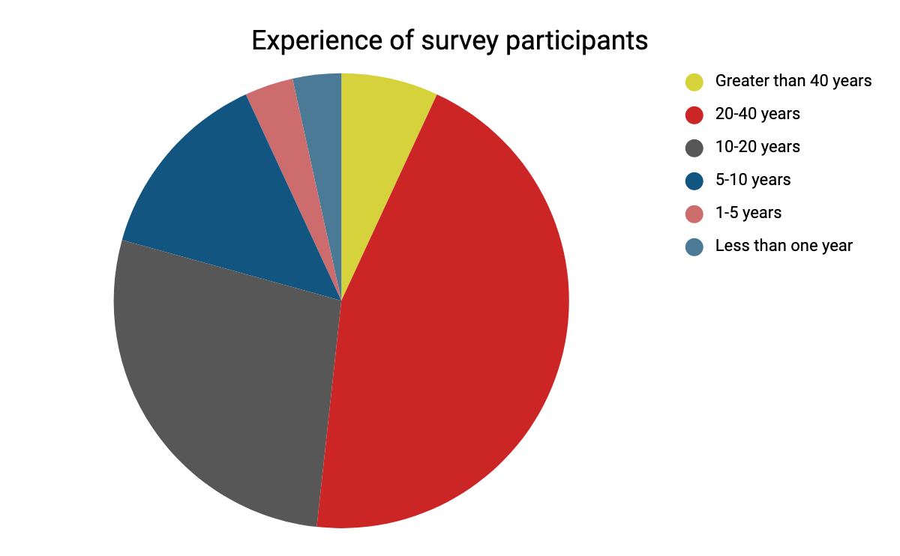
Federation 2.0
Spring:
developed the survey,
executed survey and hosted 7 guided conversations,
29 written survey responses.
Preparation for Workshop:
analyzed responses,
determined areas of uncertainty.
Goal of Workshop:
choose two dimensions of uncertainty,
in the four resulting quadrants, tell a story of that future.

Slide 12
Federation 2.0
Tensions affecting possible futures
Mission of The Academy: Internal vs External Priorities The forces that affect which and how academic objectives are pursued
Resources for The Academy: More vs Less The responses when resources expand or contract
Impact of Social-Technological Change on The Academy: Slower vs Faster The choices to retain academic distinctiveness or become more like the surrounding culture
Inequity in The Academy: More vs Less The impact of regional resource disparity

Slide 13
Federation 2.0
Tensions chosen
Abundant vs scarce resources Extrapolate from stories to the different scales – even with global resource abundance, would all endeavors have equal resources?
Autonomy vs strong direction The rate of change in the academy and resource allocation seemed linked to how directed or incentivized different research and education programs would be.

Slide 14
Federation 2.0
Abundance
Tinder for Collaboration
Mission Accomplished
I Will Survive
Multiply or Divide
Autonomy
Direction
Scarcity

Slide 15
Federation 2.0
Autumn working group efforts have included examination of:
the effects of the quadrant on stakeholders,
the implications of the scenarios for federations,
the values federations offer (look-back to surveys),
the mission of federations.
To hear more about the scenarios developed and the draft mission statement, join us tomorrow:
The Future of Federation Tuesday 10 December 11:20AM-12:10PM Oak Alley (4th)

Slide 16
IoLR
WG Chair: Pete Birkinshaw
Wiki page: https://wiki.refeds.org/display/GROUPS/IoLR
Description:
Specify how an IdP of Last Resort (IoLR) should be structured
Establish processes for reviewing and approving IdPs that seek to be designated as "Un-Affiliated IdPs", or informally, "IdPs of Last Resort" that meet the Service Providers' requirements
Group is largely dormant right now

Slide 17
SIRTFI
WG Chair: Tom Barton
Wiki page: https://wiki.refeds.org/display/GROUPS/SIRTFI
Description:
looking at processes for expressing security incident handling requirements as an assurance profile for federations and other requirements needed to effectively deploy and enhance incident response processes for FIM

Slide 18
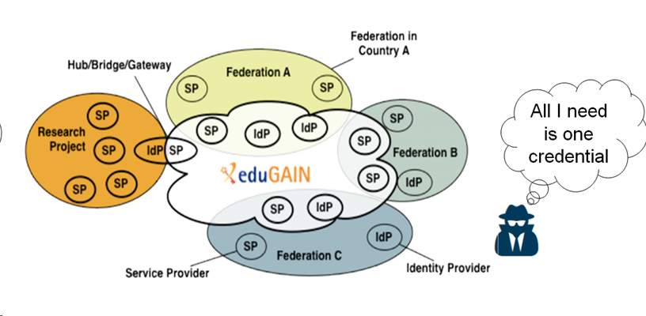
SIRTFI - security incident response trust framework for federated identity
SIRTFI
Be willing to collaborate in responding to a federated security incident.
Apply basic operational security protections to your federated entities
in line with your organization’s priorities.
Self-assert SIRTFI “tag” so that others will know to trust this about you.

Slide 19
Overall arc of work¹
SIRTFI
Phase 1 | Sirtfi v1.0 and related | Done
Phase 1 | Establish means to indicate compliance and how to contact | Done
Phase 2 | Define roles and responsibilities of the various parties in managing federated security incidents, information sharing guidelines, tools, procedures, and templates | In process
Phase 3 | Establish means for proactive notification of an account compromise when it can be expected to produce a substantial impact to an at-risk SP organisation | Queued
[1] https://wiki.refeds.org/display/GROUPS/SIRTFI

Slide 20
Update on open tasks
SIRTFI
Define incident response procedures for federations | Stopped work on Federated Incident Response Handbook. Instead revising AARC DNA3.2 paper to add to its practical aspect.
Incident response tabletop exercises | Taken up by Security Communications Challenge Coordination Joint Working Group
Security contact freshness | InCommon-Sirtfi proof of concept group to field test process to maintain contact info freshness
Communication channels for sharing incident information | Focus on common means of making TLP White/Green information widely available
Sirtfi+ Registry | Geant incubation task. One motivating use case has evaporated.

Slide 21
SIRTFI across proxies
SIRTFI
How can a downstream Relying Party, that may be one or more proxy hops distant from their users’ IdPs, be notified of account compromise?
Need Sirtfi v2, which will add notification to what’s in Sirtfi v1
But need much more as well
Discussed at yesterday’s FIM4R meeting
Stay tuned!

Slide 22
SPOG
WG Chair: Laura Paglione
Wiki page: https://wiki.refeds.org/display/GROUPS/SPOG
Special membership rules:
Modeled off FOG; open to Service Providers registered in any Federation
Operating rules:
Participants of this list are free to use the information received, but neither the identity nor the affiliation of the source(s), nor that any other participant, may be revealed. If this cannot be ensured, redistribution of any information received requires prior express permission from the source(s).
Discussions are focused on access and authorization topics of interest to services

Slide 23
SPOG - UPDATE
Launched just after TNC (July 2019)
29 members so far
Looking for more participants!
Formation was met with pushback & skepticism (fear?)
Conversations so far have been of several types:
Introductions – who is here & what is your service
Advice – who has experience doing something and can share
Level setting – Is there anything that this group should focus on
Come to session on Wednesday afternoon to hear details
Wednesday 1:40 – 3:30
Federations: We Got Issues! (not just SPOG)
Bayside A/B/C (4th)

Slide 24
Schema Editorial Board
SEB Chair: Benn Oshrin
Wiki page: https://wiki.refeds.org/display/STAN/Schema+Editorial+Board
Special membership rules:
Direct participation in the Schema Board is also governed by the Schema Board Terms of Reference
Description
responsible for the various schema managed and maintained by the REFEDS community
eduPerson
SCHAC
voPerson
isMember
hasMember
…

Slide 25
Schema Editorial Board
Responsible for the various schema managed and maintained by the REFEDS community
Actively Maintained | In Transition | Proposed
eduPerson SCHAC | voPerson | eduMember eduCourse eduOrg ?
25
Notes:
25

Slide 26
Schema Editorial Board
The Board consists of up to 10 members, elected to staggered two year terms:
David Banz (U. Alaska) (2019-2020)
Alan Buxey (UNiDAYS) (2019-2021)
Keith Hazelton (Internet2) (2019-2021)
Scott Koranda (LIGO/SCG) (2019-2020)
Miro Milinovic (SRCE) (2019-2020)
Benn Oshrin (SCG) (2019-2021, Chair)
Mario Reale (GARR) (2019-2021)
Catarina Ribeiro (University of Porto) (2019-2020)
Terry Smith (AAF) (2019-2021)
Heather Flanagan (ex officio, Secretary)
Elections for four seats next year
26
Notes:
26

Slide 27
Schema Editorial Board
2019 In Review:
Bootstrapping, lots of effort to revise the Terms of Reference
Various revisions to eduPerson
Established voPerson Subcommittee
Started work to unify schema publishing (ie: using git to track schema revisions)
27
Notes:
27

Slide 28
Schema Editorial Board
Participation:
Join the schema-discuss list
Join a subcommittee
Propose revisions to the existing schema
Nominate candidates for the next election cycle
28
Notes:
28

