Slide 1
WG Update: Security Incident Response
REFEDS @ TNC18
June 10th 2018, Trondheim
Slides by Tom Barton (Internet2, Uni Chicago)
Presented by Hannah Short (CERN)

Slide 2
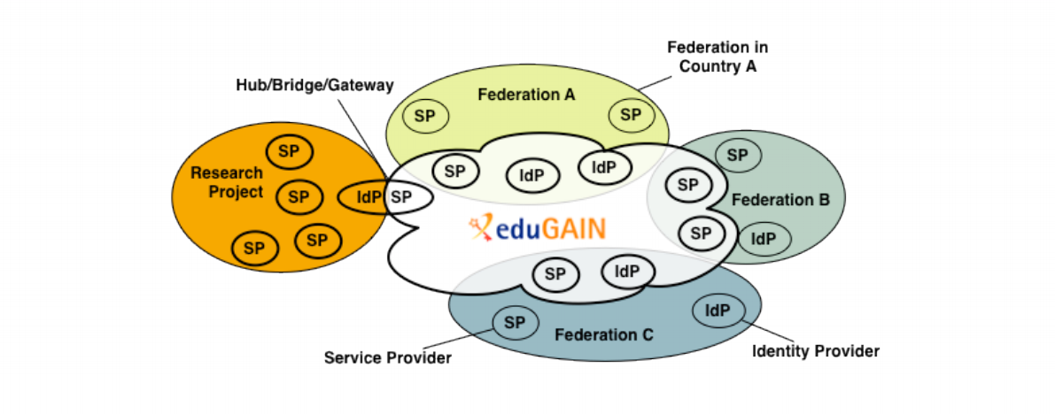
Recall the need for federated security incident response
All I need is one credential
Notes:
No need to explain much, just that we all must be prepared for when a bad guy gets loose in FIM
Over the past few years the REFEDS Sirtfi WG has defined a trust framework and assurance profile that identifies a baseline of security practices

Slide 3
Adoption stats of Sirtfi framework as of 8 June 2018
We’ve a long ways to go!
 | IdPs | SPs | Feds
Tag - MET | 277 / 4819 | 384 / 11034 | 16* / 63
Tag - eduGAIN | 266 / 2739 | 72 / 1994 | 22 / 51
Security contact - eduGAIN | 943 / 2739 | 441 / 1994 | 29 / 51
* reported in REFEDS 2017 survey
Notes:
MET is data across all R&E Feds. eduGain covers published entities. Although there are now 22 Feds with some Sirtfi, it’s still not clear that there is much *active* support and encouragement for further adoption. Maybe ask for show of hands in the room, do some friendly yet public shaming.

Slide 4
Current Work in REFEDS Sirtfi WG
Incident Response Readiness
Sirtfi Registry
Tabletop exercises

Slide 5
Current work https://refeds.org/sirtfi
Complete the Incident Response readiness picture
Sirtfi itself addresses federation member organisations
New document will identify roles, responsibilities, procedures for other federation actors
R&E federation operators
eduGain operator
Research community proxy operators
Security incident analysis/response organisations
Based on AARC DNA3.2

Slide 6
Current work https://refeds.org/sirtfi
Sirtfi+ registry
Work around problem of some R&E federations not yet facilitating Sirtfi adoption by their members
Enable research communities to quickly establish security incident response capability across connected federation + e-infrastructure entities
Service permitting authorized persons to register Sirtfi attestation and security contact
Who will agree, and be trusted, to operate the Sirtfi+ registry?
How will authorised updaters be identified?
Notes:
The technology with which to build the service is not a problem. The hard parts are the last two questions. Maybe people in the room have ideas?

Slide 7
Current work https://refeds.org/sirtfi
Tabletop Exercise
Simulate incident scenarios
Identify weaknesses in current practices
Train participants

Slide 8
Federated incident response tabletop exercise scenario
Nikhef RCAuth
INFN user
One Service Provider discovers a compromised user and alerts the Identity Provider of this user. Additional affected services are identified and should be able to see activity by the Identity in their logs.
INFN
IdP
LIGO Wiki &
CERN Market
Notes:
Clunky imitation of your slide!

Slide 9
Lessons learned
Ad hoc setup and flow of information across participants
Lack of established policy & process to guide response activities and address questions of sharing incident data with unfamiliar people
Tooling missing
How to do emergency suspension in a Shibboleth SP is not widely documented
Difficulties with security contacts
Input to ongoing work in GN4 to define requirements for eduGAIN support regarding Security (in fact, eduGAIN were partcipants)
Notes:
Selected – you don’t have time to say everything that’s important.

Slide 10
Sirtfi Contact Choice
Who is being listed as REFEDS Security contacts?
Difficulties experienced in tabletop
Where can I find the contacts?
Which should be used if there are multiple?
Where are the contacts for Federation Operators?
95% list only 1 contact
10% list only individuals
eduGAIN metadata analysis, May 2018

Slide 11
Next tabletop, Autumn 2018
Find new participants (volunteers???)
Follow new Sirtfi procedures, or AARC’s if Sirtfi’s aren’t ready.
Check on work beginning in WISE to understand needs for wide scale security communication challenges
Improve design of tabletop methodology

