Slide 1
Cross-sector and user-centric AAI
Expanding federations beyond R&E
Maarten Kremers
Task Leader Trust and Identity Technology Development, GN4-2 Project
Technical Product Manager, SURFnet, The Netherlands
Internet2 Technology Exchange 2016
26th September 2016

Slide 2
Going cross-sector and user-centric
Collaboration is worldwide & cross-sector
Authentication and Authorisation Infrastructure (AAI) services will be deployed to cope with the challenges of access to networks and their connected services. These developments include:
Global and cross-sector, interfederated AAI service provision for the whole of the European R&E community and potentially, the rest of the world.
GÉANT Strategy2020

Slide 3
Going Cross-sector with GovID’s
The eIDAS Regulation:
ensures that people and businesses can use their own national electronic identification schemes (eIDs) to access public services in other EU countries where eIDs are available,
creates an European internal market for eTS - namely electronic signatures, electronic seals, time stamp, electronic delivery service and website authentication - by ensuring that they will work across borders and have the same legal status as traditional paper based processes. Only by providing certainty on the legal validity of all these services, businesses and citizens will use the digital interactions as their natural way of interaction.
The Regulation (EU) N°910/2014 on electronic identification and trust services for electronic transactions in the internal market (eIDAS Regulation)

Slide 4
Going Cross-sector with GovID’s
STORK
STORK 2.0
eIDAS
STORK 2.0 / eIDAS
≠
SAML2int (eduGAIN)

Slide 5
Use Cases & PoC
Use case 1:
A user with a STORK eID accesses a service provided by an SP in one of the eduGAIN Federations.
Use case 2:
A user with an account on an IdP in one of the eduGAIN Federations accesses a service provided by STORK in one of the STORK enabled member states.

Slide 6
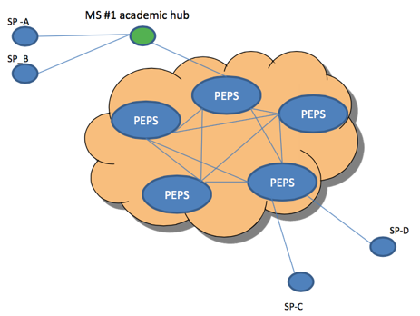
Use Cases & PoC
STORK/eIDAS : 1 node per country, full mesh between nodes

Slide 7
Use Cases & PoC
eduPEPS: the development of a proxy element:
* Situated between a STORK federation and an eduGAIN federation
* Providing a trusted entity for both the STORK and the eduGAIN federations.
* Acts as a protocol translation bridge
PoC worked out well
Deployment options: 1 proxy per country ? 1 proxy for eduGAiN ?

Slide 8
Next Steps
Redevelopment of the eduPEPS proxy
STORK 2.0
eIDAS

Slide 9
Next Steps
Pilots with several eIDAS eIDs
Technical requirements for interfederations
Mapping assurance levels
eIDAS eIDs to login to eduGAIN service
Use of eIDAS for higher level of Assurance
Combining eID assertions and university attributes

Slide 10
More information
REFEDS blogpost interoperability https://refeds.org/a/1257

Slide 11
User-centric
The EduKEEP architecture aims at transforming current Identity Federations to provide a user-centric approach for managing digital identities, that will bring user experience and simplicity of use at the heart of its processes

Slide 12
Starting Points User-Centric Identity Management Model
Split Authentication and Authorisation (Attributes, Groups, Entitlements)
Persistent Digital Identity:
Same ‘identifier’ over time
Longevity
Make the identity reusable instead of the the lifetime of a specific role → Attributes will changes over time for one identity (e.g. affiliation)
Inclusiveness
To include individuals who are not (currently) affiliated with an organisation

Slide 13
Starting Points User-Centric Identity Management Model
Low and high quality identities:
To lower the entry burden for individuals accessing resources without high demands on quality → self-asserted basic attributes
increase quality as needed → Enrich the identity with institutional attributes, increase LoA via vetting procedures
Possibly build on eGov / eIDAS / BankID initiatives
Service Provider can be a university, VO, Third Party, Cross-Sector

Slide 14
More information
High Level Architecture document https://wiki.geant.org/display/gn41jra3/Task+1+-+Attributes+and+Authorisations

Slide 15
Next Steps
Best Practices for User Centric Federated Identity
What’s out there, Architecture, Policy, Interfederation
Pilots

Slide 16
Next Steps
https://wiki.geant.org/display/gn42jra3/T3.1B+User-centric+identity+federation

Slide 17
Maarten Kremers
maarten.kremers@surfnet.nl

