Slide 1
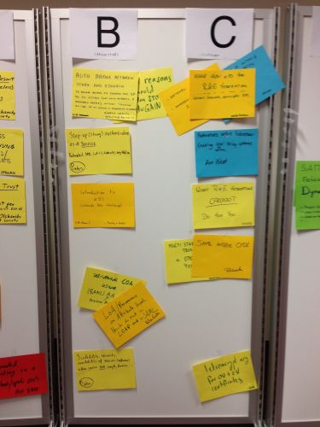
European Workshop on Trust and Identity
Date: 30 November – 3 December 2015
Location: Vienna, Austria
Organisers: Identinetics
Agenda: FIM4R (Monday), REFEDS and eduGAIN (Tuesday), EWTI (Wednesday and Thursday)
Website: https://identityworkshop.eu/ewti-2015

Slide 2


TNC16 - Building the internet of people
Date: 13-16 June 2016
Location: Prague, Czech Republic
Local host:
Call for proposals:
GÉANT invites community members to bring to the table their proposals for topics, sessions, lightning talks, posters and demonstrations.
Deadline: 30 November 2015
Website: http://tnc16.geant.org

Slide 3












Slide 4
A word for our sponsors

Slide 5

Many thanks to….

