Slide 1
GN4 Project Update “SA5”, or Identity Stuff
Nicole Harris, GÉANT
REFEDS @ Internet2 Technology Exchange 2015
Sunday 4th October 2015

Slide 2
Who’s who?
Harmonisation
eduGAIN
Federation as a Service
Non Web
Enabling Users
GÉANT AAI
eduroam
VOPaaS & InAcademia
Nicole Harris, GÉANT
Rhys Smith, JISC
Brook Schofield, GÉANT
Marina Vermezovic, AMRES
Niels van Dijk, Surfnet
Lukas Hämmerle, SWITCH
Mandeep Saini, GÉANT Assoc.
Miroslav Milinovic, CARnet/SRCE

Slide 3
The eduGAIN family in GN4 Service Development (SA5)
eduGAIN
Federation as a Service
Enabling Users
Federation as a Service
VO Platform as a Service
Pilots
Consultancy
SP registration simplification
eduGAIN technical development, inc. portal
Federation development
InAcademia
Harmonisation
Entity Categories
CoCo
Federation Practices
Assurance Business Case
Interoperability
Non web
Moonshot
ECP
New Task
New Subtask/work area
Notes:
Note, new to be funded in GÉANT, not new per se

Slide 4
Service Development (SA5) Trust and Identity Harmonisation
Federation Practices
Assurance Business Case
Interoperability
Cost-benefit analysis for campuses adopting assurance profiles.
Complete STORK-eduGAIN interoperability pilot and eIDAS scoping.
Establish common Metadata Registration Practice Statement.
Entity Categories
Support the rollout of “Research and Scholarship” and “Code of Conduct” categories.
Code of Conduct
Continue development of non EU / EEA Code of Conduct.
Support the creation of “Affiliation” and “Academia” categories.
Ensure compliancy with changing Data Protection legislations.
Work with WP29.
Support non-SAML profiles in eduGAIN.
Make recommendations on metadata publication processes.
Scoping of step-up assurance service options.
Define service requirements for FedLab offering.
New Subtask/work area
Notes:
Note, new to be funded in GÉANT, not new per se

Slide 5
Research and Scholarship
Date | IdPs | SPs | Federations
10 September 2105 | 39 | 46 | DFN, CESNET, SWITCHaai, UK, SWAMID, Aconet, InCommon, Feide. (8)
03 October 2015 | 43 | 51 | DFN, CESNET, PIONER.Id, SWITCHaai, UK, SWAMID, Aconet, InCommon, Feide, SurfConext, IDEM. (11)

Slide 6
CONSENT | The data subject has unambiguously given his consent.
CONTRACTUAL | Processing is necessary for the performance of a contract to which the data subject is party.
LEGAL OBLIGATION | Processing is necessary for compliance with a legal obligation to which the data controller is subject.
VITAL INTEREST | Processing is necessary in order to protect the vital interests of the data subject.
PUBLIC INTEREST | Processing is necessary for the performance of a task carried out in the public interest or in the exercise of official authority vested in the controller or in a third party to whom the data are disclosed.
LEGITIMATE INTERESTS | Processing is necessary for the purposes of the legitimate interests pursued by the controller or by the third party or parties to whom the data are disclosed.

Slide 7
What do the important people say?
Article29 Working Party:
"The current text of Article 7(f) of the Directive is open ended. This flexible wording leaves much room for interpretation and has sometimes as experience has shown led to lack of predictability and lack of legal certainty. However, if used in the right context, and with the application of the right criteria, as set out in this Opinion, Article 7(f) has an essential role to play as a legal ground for legitimate data processing.”
7(f) = legitimate interests

Slide 8
What do the important people say?
Article29 Working Party:
"...an appropriate assessment of the balance under Article 7(f), often with an opportunity to opt-out of the processing, may in other cases be a valid alternative to inappropriate use of, for instance, the ground of 'consent' or 'necessity for the performance of a contract'. Considered in this way, Article 7(f) presents complementary safeguards - which require appropriate measures - compared to the other pre-determined grounds.”
PERFORM A BALANCE TEST

Slide 9
SAFGUARDS
TRANSPARENCY
IMPACT MANAGEMENT
LEGITIMATE REASONS
BALANCE
CASE BY CASE
https://wiki.refeds.org/display/ENT/Guidance+on+justification+for+attribute+release

Slide 10
7-STEP PLAN
STEP ONE
Check that Legitimate Interests is the best approach.
STEP TWO
Qualify the legitimacy of the request – lawful, clearly articulated, real need.
STEP THREE
Determine whether the processing is necessary to achieve the goal.

Slide 11
7-STEP PLAN
STEP FOUR
Balance the data controller’s needs against the interests of the subjects.
STEP FIVE
Identity safeguards you can put in place (tech design etc).
STEP SIX
Demonstrate (publish) compliancy.
STEP SEVEN
Allow the user to opt-out.

Slide 12
Where?
https://wiki.geant.org/display/gn41sa5/Task+1++-+Harmonisation

Slide 13
What will you see?
The “Academia” conversation - hopefully Leif will arrive.
Paper on the value proposition for statistics and next steps proposal.
Paper on how to make edugain technology neutral.
Push for entity category adoption.
Business case on assurance for IdPs.
Metdata Registration Practice Statement for eduGAIN. (publication?)

Slide 14
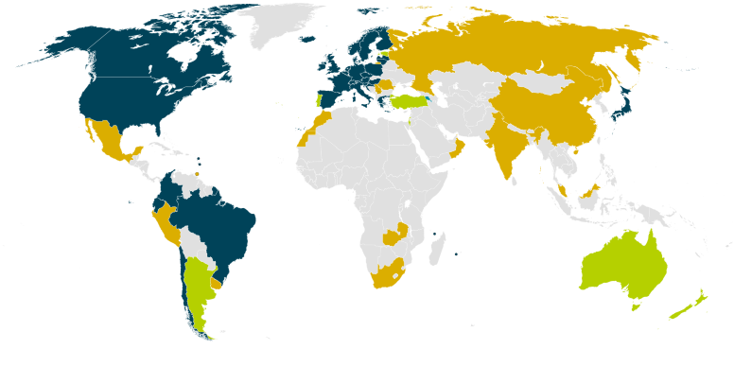
The eduGAIN context Growth & Maturity
eduGAIN Members
Joining eduGAIN
Other federations
Notes:
Ref growth in entities, growth in federations
C30 federations, over 2000 entities (since november)

Slide 15
Trust and Identity Harmonisation Relationships
Harmonisation
Non Web
Entity Categories
REFEDS
Code of Conduct
eduGAIN
Federation Practices
AARC
Assurance Business Case
Enabling Users
Interoperability
Notes:
Note, new to be funded in GÉANT, not new per se

Slide 16
In depth – Assurance REFEDS/GÉANT/AARC working together
AARC & Enabling Users
REFEDS
Harmonisation
eduGAIN
Requirements
Pre-existing design work
Profiles
Experiences
Pilot (P2)
Incorporate (P2, P3)
Develop business case (P1)
Specific
Anchored in real use cases
Costing
Supply chain
Training
Don’t reinvent wheels – do try to really use them
Notes:
Talk about this also as a general principle.
It makes sense to talk about some things in REFEDS.
eduGAIN internal stuff is less about being secret, and more about being specific (aka tedious).

Slide 17
SA5 at TechX
Advanced CAMP sessions.
Security Incident and Assurance in FIM: Monday 11:20am.
Moonshot: Tuesday 2:25pm.
VAMPIRE (GÉANT VO): Tuesday 3pm.
VO Platform as a Service: Tuesday 3.25pm.
Lightning Talk on InAcademia: Tuesday 3pm.

Slide 18
Questions?

